Slide 1

Meet the Teacher
Tuesday 12th September 2023
Miss Barber- fbarber@winterbourneearls.wilts.sch.uk
Mrs Longhurst - nlonghurst@winterbourneearls.wilts.sch.uk

Slide 2
To Do!
Timetable
Website/Blogging
Curriculum
Homework
Trips
Stationery

Slide 3
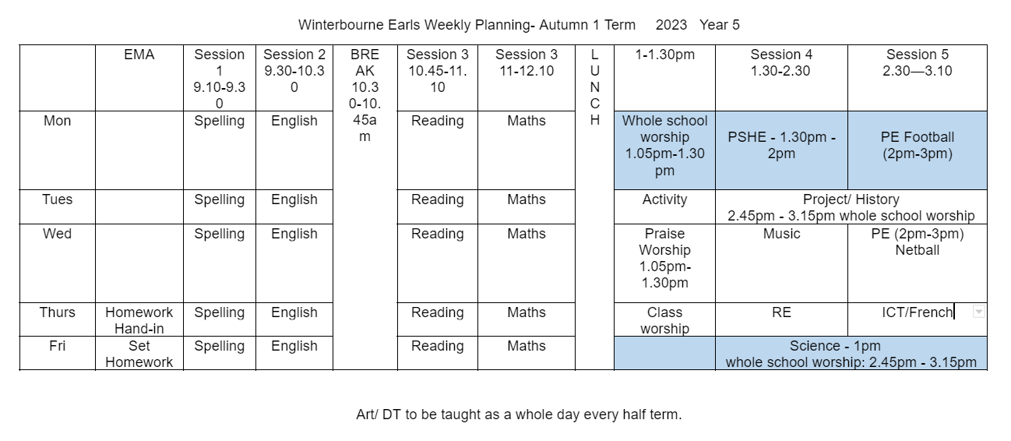

Timetable

Slide 4
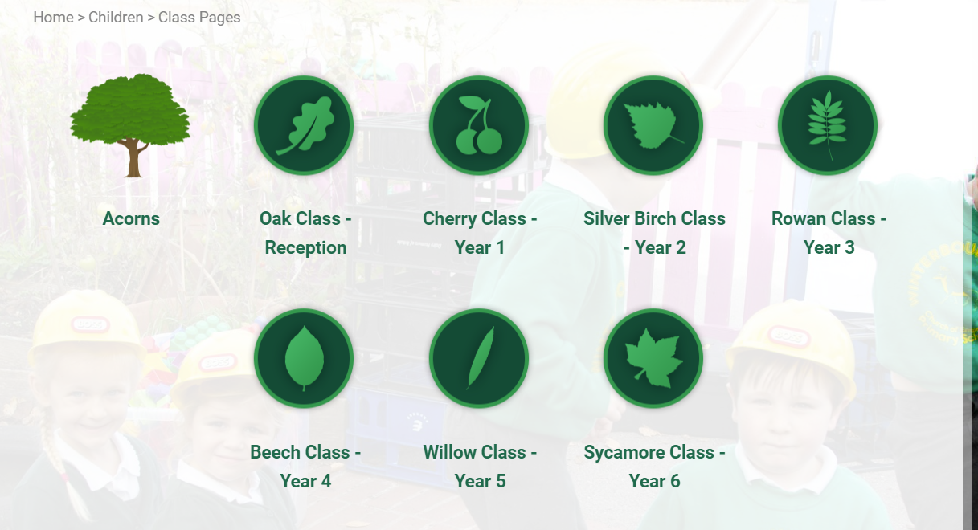
Website & Blogging
https://www.winterbourneearls.org/willow-class-year-5/

Slide 5

Curriculum
Ancient Greece – ‘Are you a thinker or a fighter?’
The Rainforest – ‘I’m a year 5 get me out of here!’ What is happening to the rainforest and the impacts.
Titanic – Turning points in history, the cause and consequence of these events

Slide 6
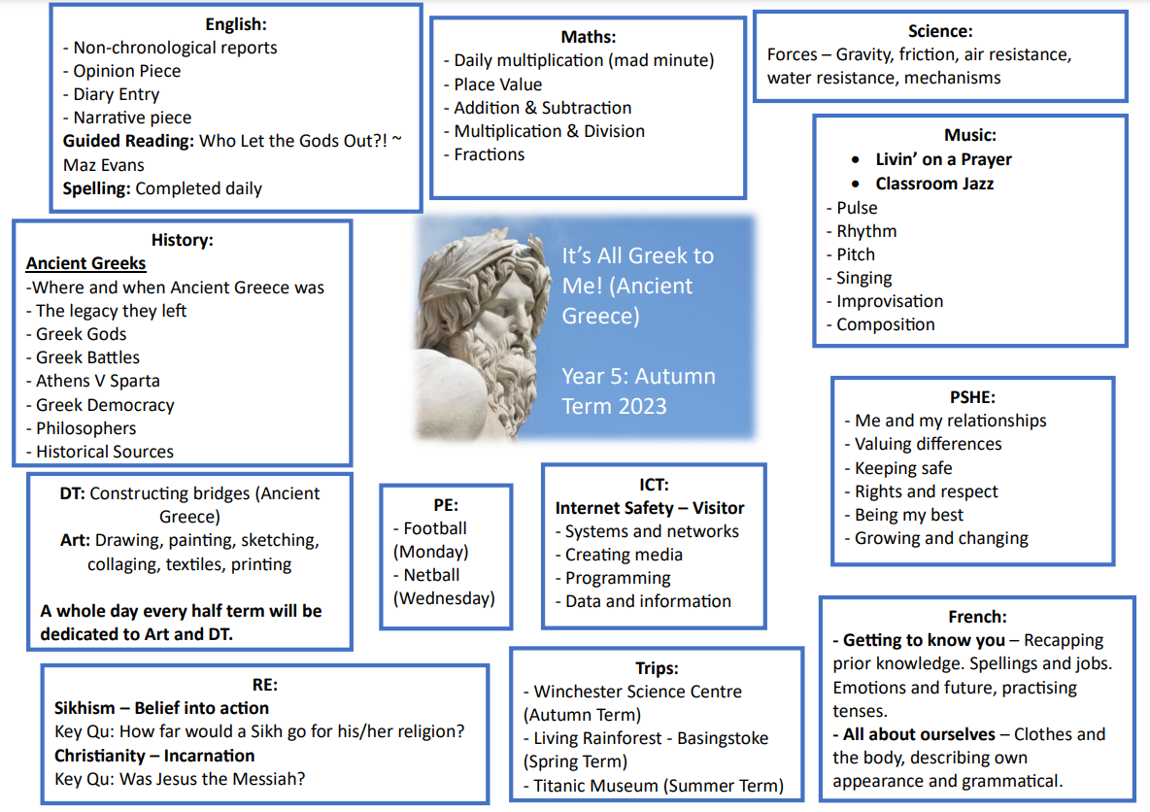

Slide 7
Homework
Basic Skills:
Reading: Daily
Children are expected to read everyday. There is space to record reading in Reading record books.
Times Tables: Daily/as often as possible
Tables Logs
Spellings: Daily/as often as possible
Word Bank + ‘Orange Words’ for each unit.
Maths:
20-40 minutes 1x a week
Maths will either be set on paper or via mathletics and will re-visit work completed in class.
Grammar & Punctuation:
10-25 minutes 1x a week (After Christmas)
Set on paper
Occasional half term ‘Make and Do’ Project.

Slide 8
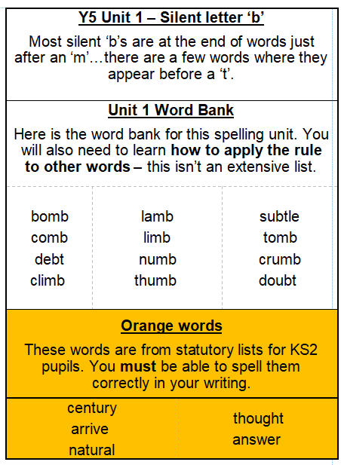
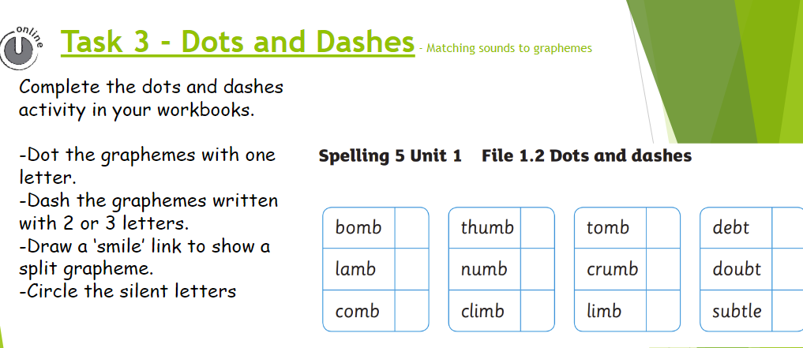

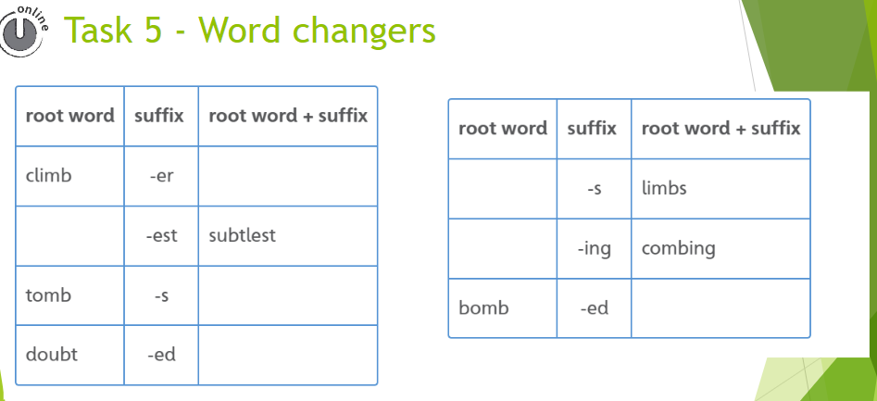
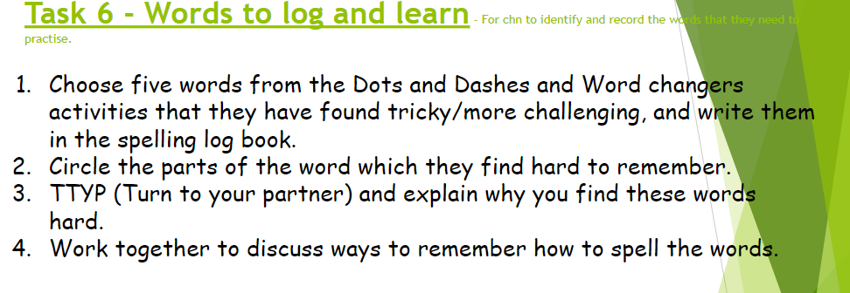

Slide 9
Trips
Sports and Enrichment
Curriculum trips
Winchester Science Centre (Autumn Term Date TBC)
Living Rainforest- Basingstoke (Spring Term)
Titanic Museum- Southampton (Summer Term)
Residentials- IN YR 6 - A more expensive trip as it is a WEEK long residential. Telling you now so that you are aware and can save accordingly. ~ £380 (£500)
Any issues, please contact Mrs Hyde.

Slide 10
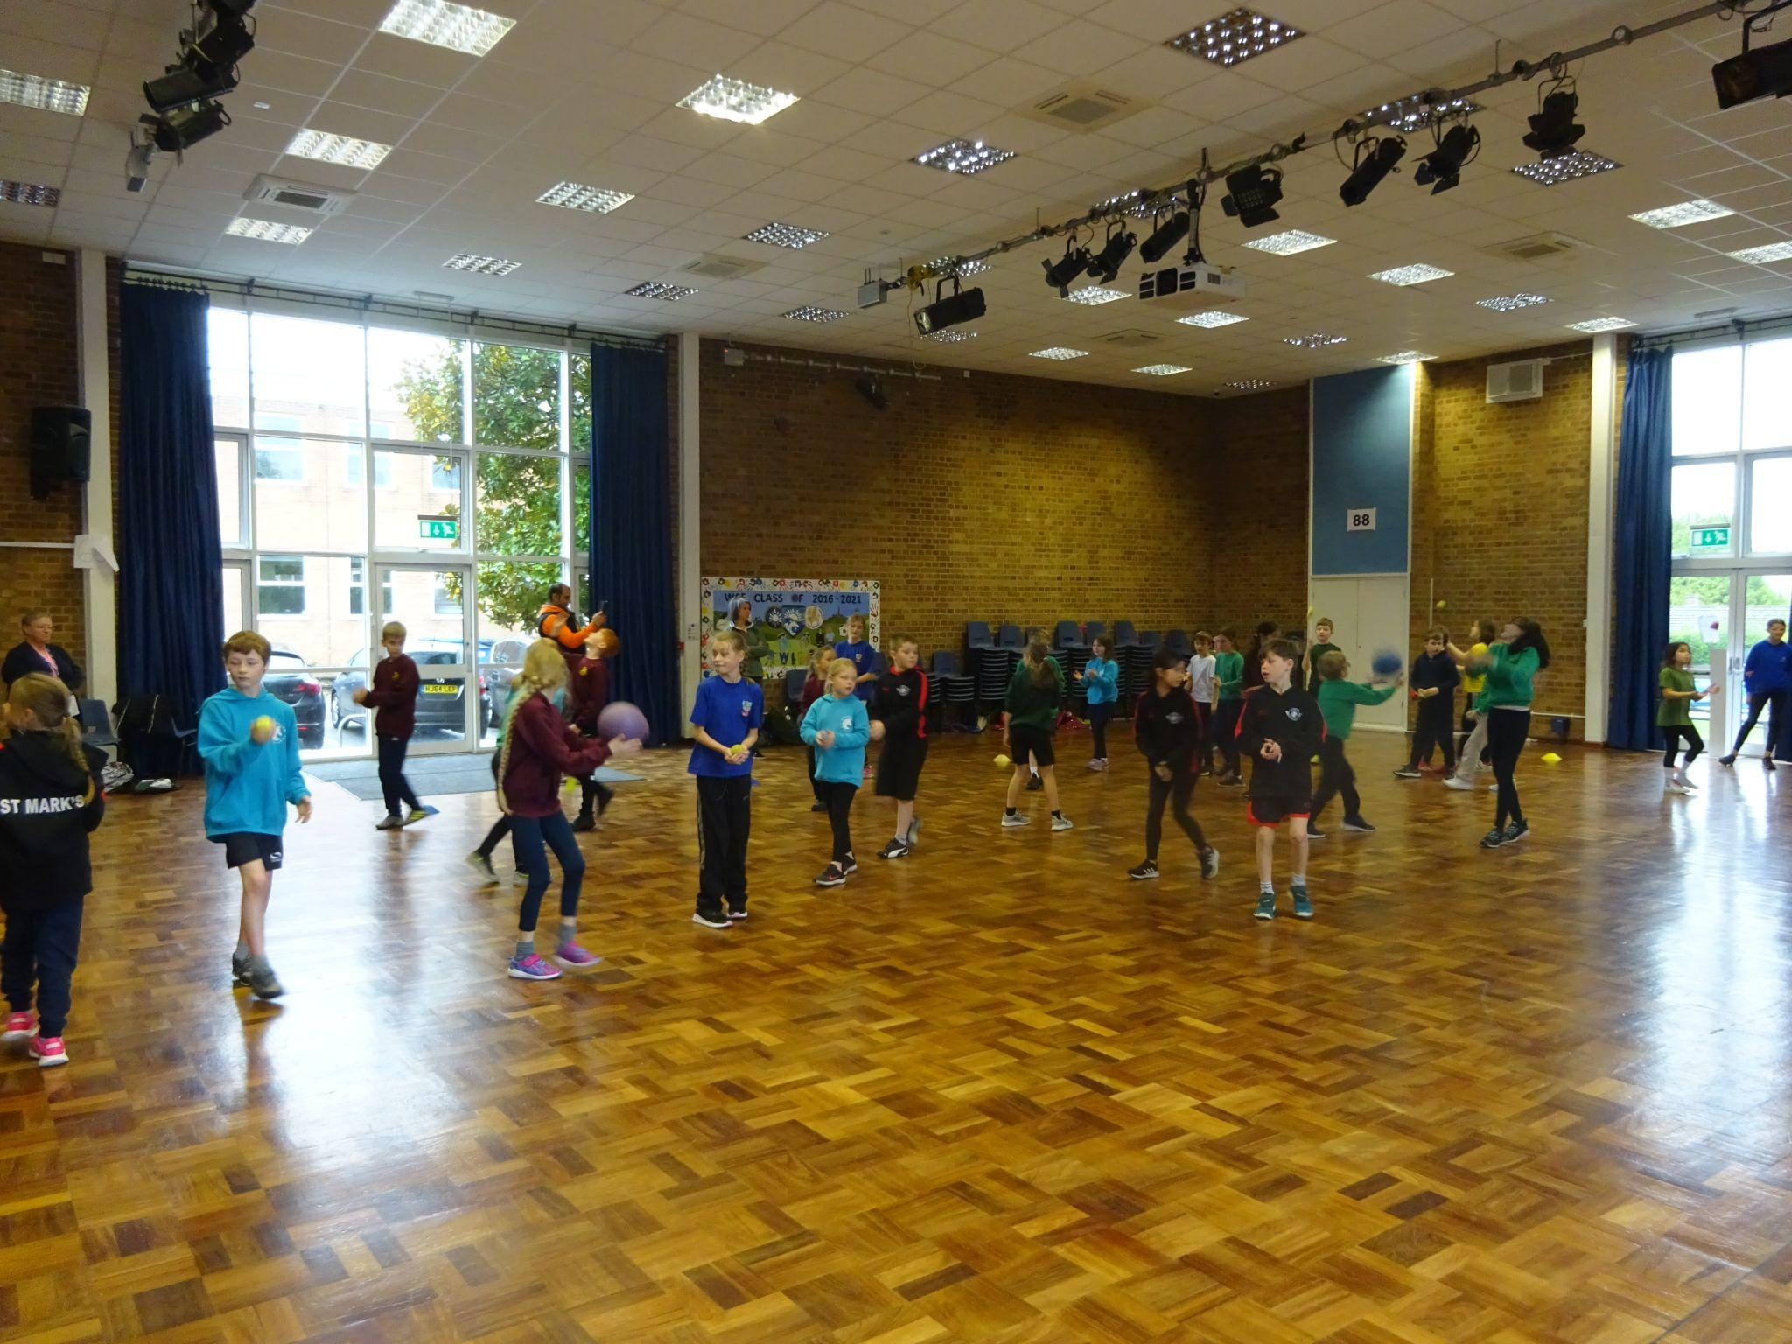
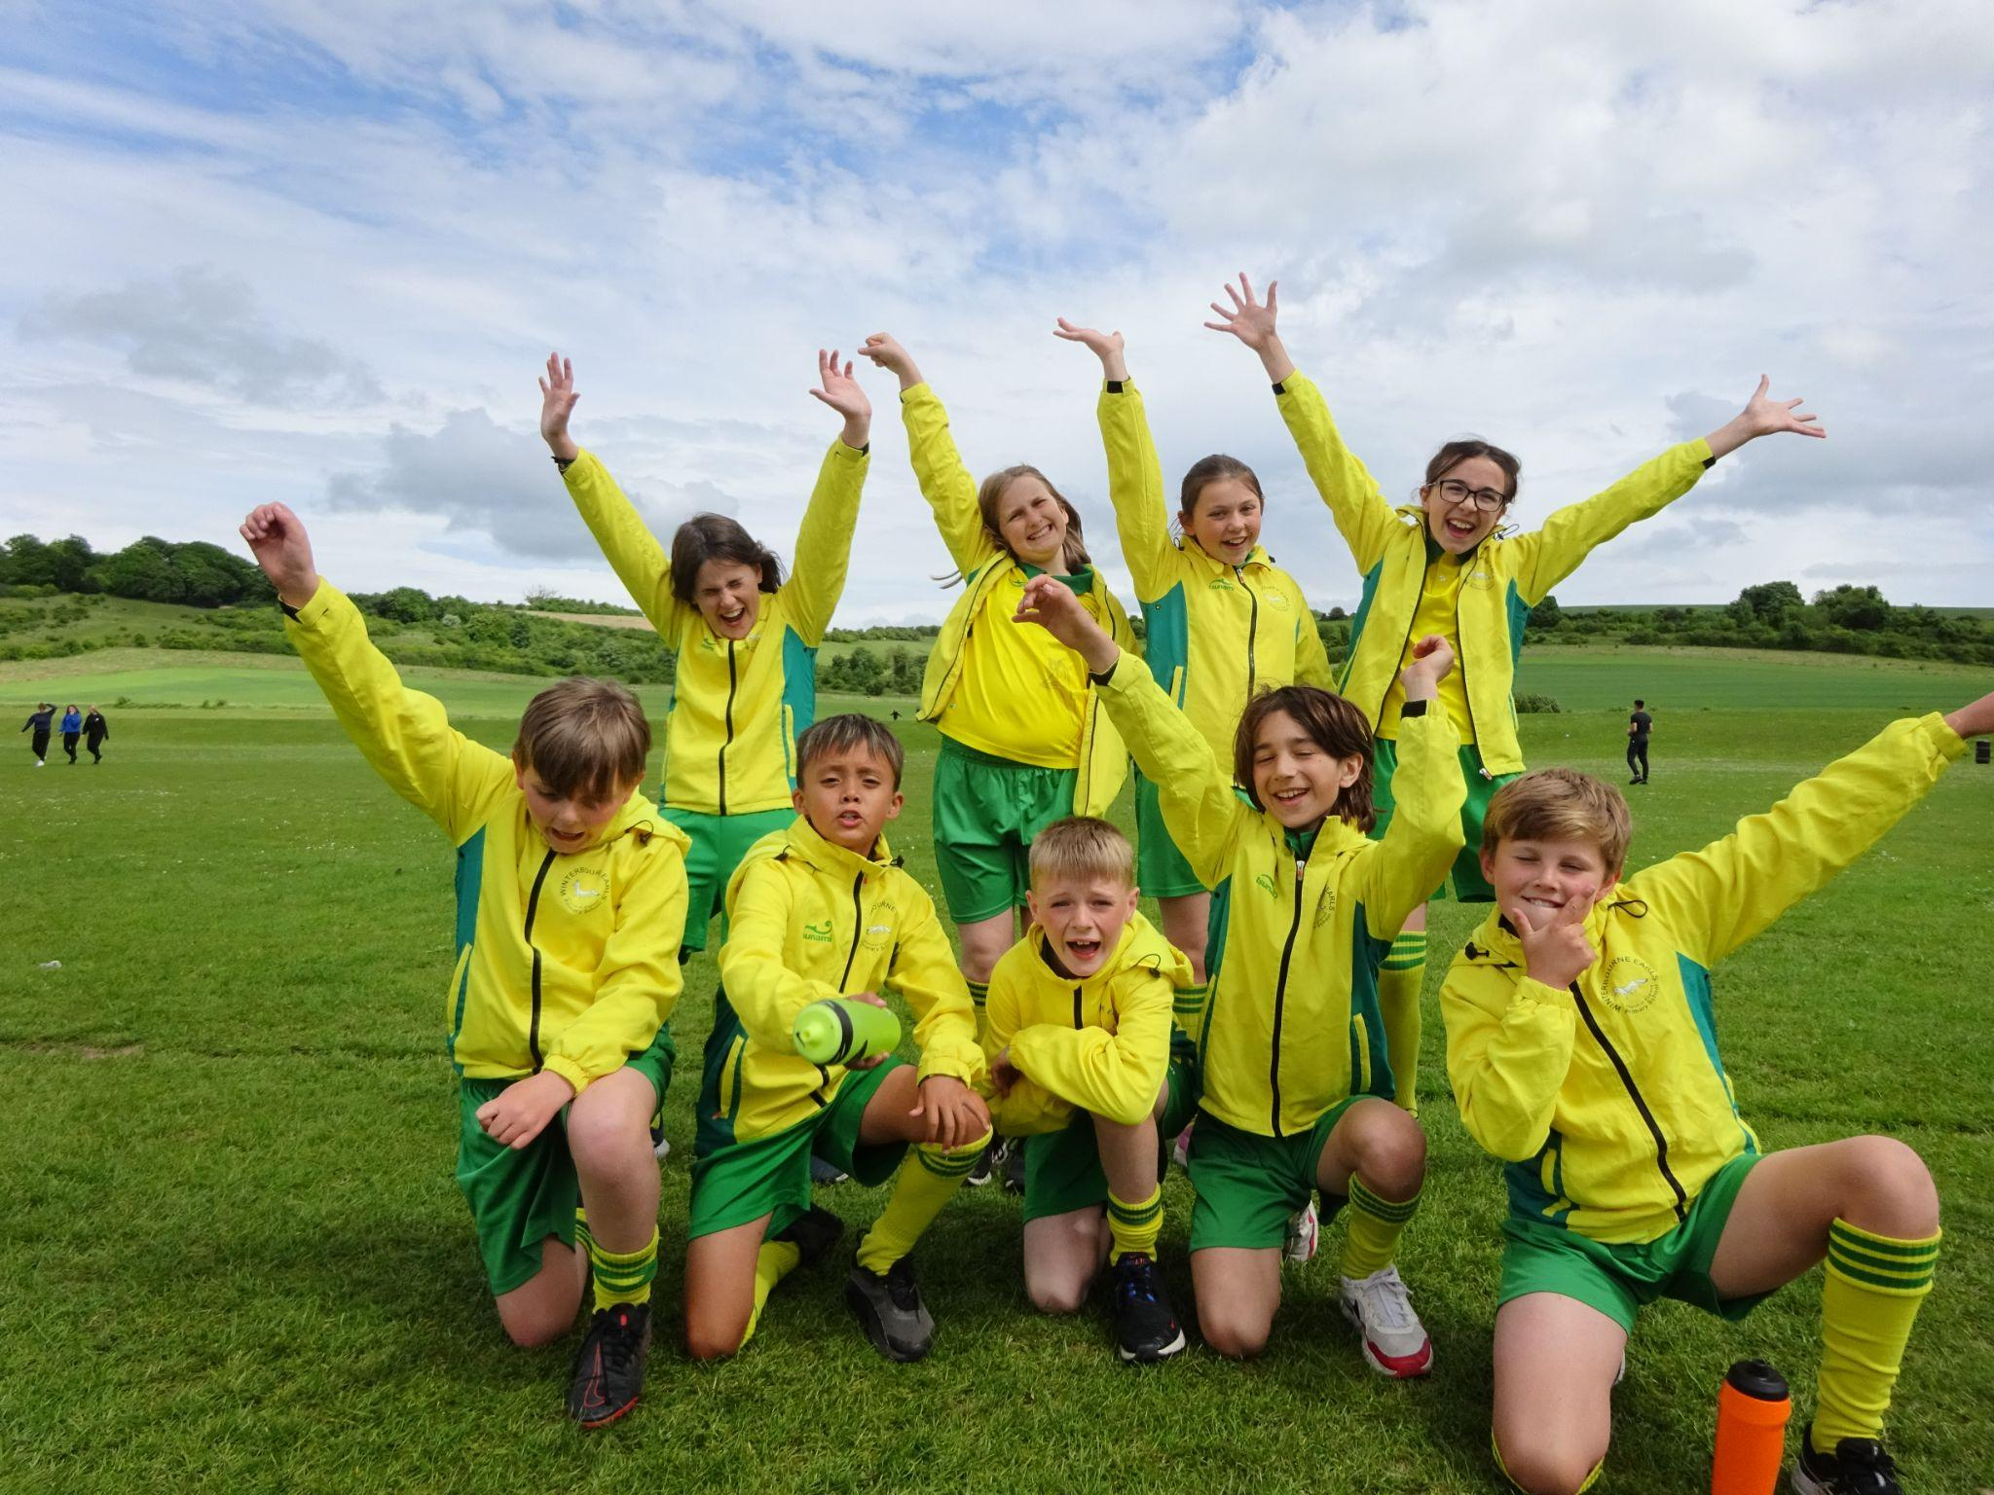
Sports and Enrichment

Slide 11
Stationery
Pencil
Blue rollerball pen (not biro)
15cm ruler
Pencil sharpener
Rubber
Glue stick
Small pair of scissors
Highlighters
A few colouring pencils
Nothing on this list is compulsory as we can provide all. Please make sure anything you do bring is labelled clearly!

Slide 12
Contact
Year 5 is not using See-Saw as a method of communication.
Please feel free to email me: fbarber@winterbourneearls.wilts.sch.uk
THANK YOU

