Slide 1
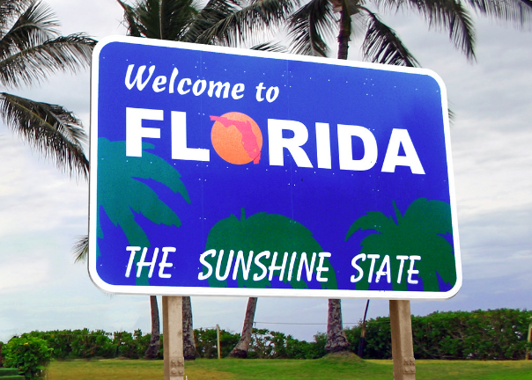
English:
Reading:
Our class text for the Autumn 1 term will be ‘The Polar Bear Explorers Club’ by Alex Bell.
Writing:
Handwriting will have a high focus during the Autumn term as we look to develop automaticity and fluency in letter formation and joining.
We will create a range of texts including, leaflets, letters, and arguments linked to our work on understanding the human geography of Theme parks.
Spelling:
Spelling lessons will take place 4-5 times a week and will build a knowledge of different spelling patterns. They will bring home a list of words at the start of each unit to learn and help them further explore the rules we are learning about.
Science:
There science for this term is learning about circuits in our electricity work. We will explore conductors, insulators and the different variables which can be included in circuits.
History/Geography:
Our Autumn 1 project focusses on building the children’s global geographical knowledge of the continents, The North American countries and the American states – particularly Florida.
We will learn about key geographical skills as well as building an understanding of the human and physical geography of Florida. We will investigate the State’s major tourism attraction as well as its physical characteristics as a peninsula that make it an ideal home for NASA and Turtles!
French:
This term, the children will be learning where they live. Learning how to talk about their local area and homes.
RE:
This term, the children will be learning about Judaism and about how special the relationship between Jews and God is. Children will learn about the story of Abraham, synagogues, and the Torah.
Maths:
Securing the children’s Times Tables facts is vitally important during Y4. by Half Term they should know : x2, x5, x10, x3, x4,
We will cover topics on Place Value, Addition and Subtraction.
Children will need to master place value of numbers to 10,000 by ensuring they can round, count on, order, compare and partition.
Addition and subtraction will ensure all pupils can use the formal column method for up to two four-digit numbers.
Year 4 – Autumn Term
2026-27
‘Florida – Beyond the Magic Kingdom’
PE:
During Tuesday PE we will be learning the fundamental movement and passing skills used in netball. Whilst on a Friday, we will be developing our precision and coordination in Tri-Golf!
Do you have a skill or job which links to any of our areas of learning?
Are you able to volunteer time to read/practise tables?
Are you a interested in textiles or food preparation?
We’d love to hear from you!
Art/DT/Music:
Our DT this half term will be to combine our understanding of electric and design to create theme park carousel rides.
Computing:
This term the children will be learning about programming. On our trip to Paultons Park we will learn how to create simple codes for rides, we will then do this for our own rides at school.

