Slide 1
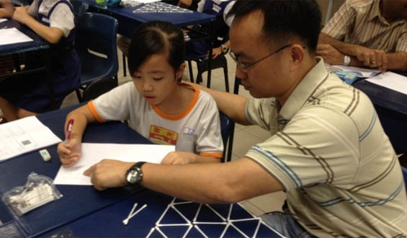

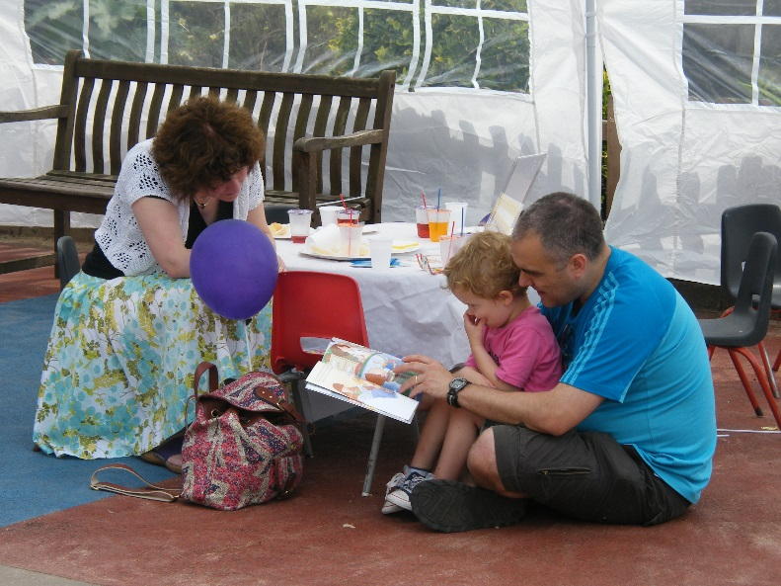

The Impact of Parental Involvement on Pupil Achievement

Slide 2
Aims of these sessions
To encourage all parents attend so that collectively they can discover the importance of parental engagement
To prove to parents and carers how critical their role is in influencing their children
To encourage parents to support the wider school life
To enthuse parents about home learning
To give parents the tools to help their children with writing/maths at home through the Impact in Learning programme

Slide 3
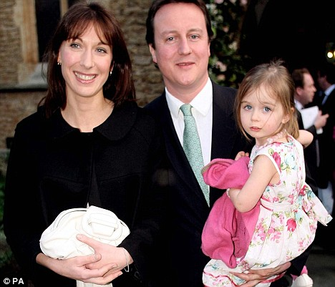
Recent thoughts on parenting
On 11 January 2016 David Cameron announced
a £70 million investment to encourage all parents to attend parenting classes:
‘Children “don’t come with a manual”.
“Is it right that all of us get so little guidance?” he asked. “What about later on, when it comes to good play, communication, behaviour and discipline? We all need more help with this – the most important job we’ll ever have.’’’
I am liaising with a highly recommended Parent Class provider and hope to launch this programme in September

Slide 4
Professor Charles Desforges
A well-respected independent educational consultant
Awarded an OBE
Special interests in teaching, learning and parental involvement
Research adviser to government bodies here and overseas
He carried out the largest co-ordinated programme of social research ever mounted in the UK
Notes:
Ted Wragg was an advocate of warmth, humour and humanity in the classroom and defended these ideals with passion against a narrow functional approach to learning; he opposed political interference and wrote extensively in the Times Educational Supplement and The Guardian

Slide 5

Notes:
Choose a different school and your child could achieve 5% better or worse but parental engagement in child’s learning can mean your child achieves 30% more (or less). We often consider what a specific child could have achieved with the right parental involvement

Slide 6


“The most important finding is that parental involvement in the form of ‘at-home good parenting’ has a significant positive effect on children’s achievement.
In the primary age range the impact caused by different levels of parental involvement is much bigger than differences associated with variations in the quality of schools.
The scale of the impact is evident across all social classes and all ethnic groups.”
(THE IMPACT OF PARENTAL INVOLVEMENT, PARENTAL SUPPORT AND FAMILY EDUCATION ON PUPIL ACHIEVEMENT AND ADJUSTMENT:A LITERATURE REVIEW by Professor Charles Desforges with Alberto Abouchaar)

Slide 7
Effects of parents v effect of schools
(2002 Sacker et al)
Achievement at | Parental effect | School effect
Age 7 | 29% | 5%
Age 11 | 27% | 21%
Age 16 | 14% | 51%
Notes:
Showing that at age of 7 parents are 6x more influential than teachers. We can help you so that you can influence your child, then worst parents changing into the best parents can make 1/3 of a difference in their child’s attainment. Key is age- need to put in the support early on. So extrapolating parent with a preschool child has 100% influence, then by year 3 has 29% influence, then at Year R and Year 1 influence has even greater impact. Leverage parents have swamps the leverage we as teachers have.

Slide 8


The Impact of Parents’ Involvement on Children’s Education (DSCF 2008 research findings):
Parental involvement in children’s education from an early age has a significant effect on educational achievement and continues to do so into adolescence and into adulthood
Family learning can also provide a range of benefits for parents and children including improvements in reading, writing and numeracy as well as greater parental confidence in helping their child at home
The quality and content of fathers’ involvement matters more than the quantity of time fathers spend with their children
Notes:
Parental involvement: Early years-parent is educator but through school joint responsibility. Family learning- what we will be doing together- child and parent learning together. Video showed workshop with parents and children learning about maths together- we are focusing on Literacy.

Slide 9
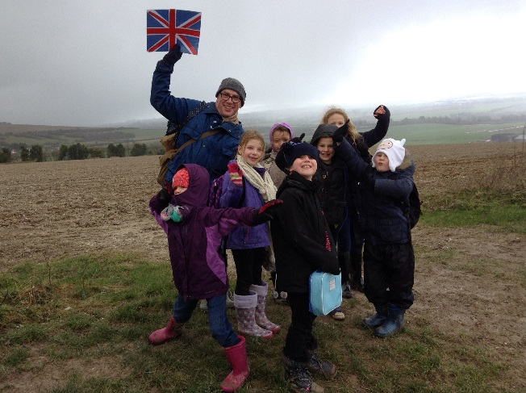
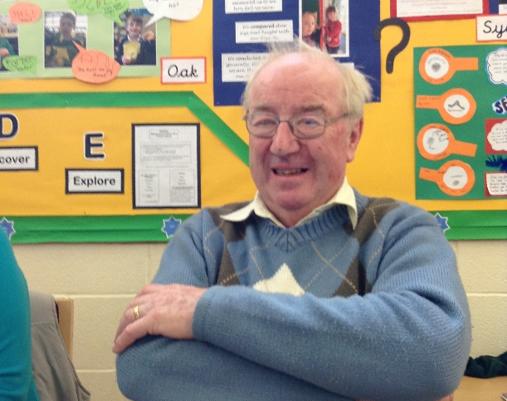
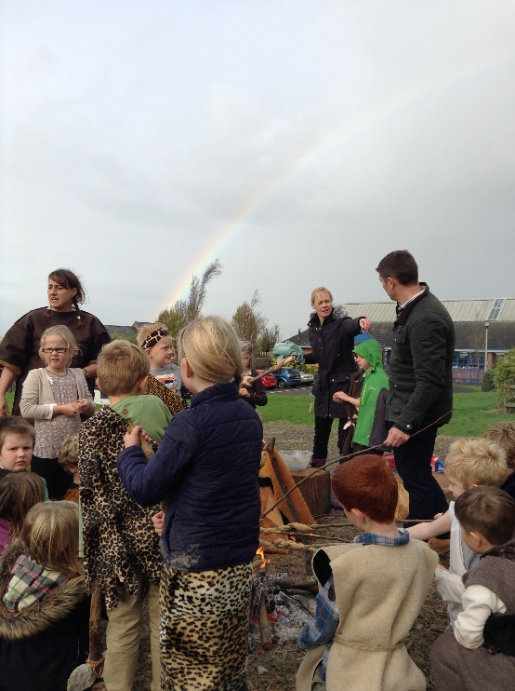
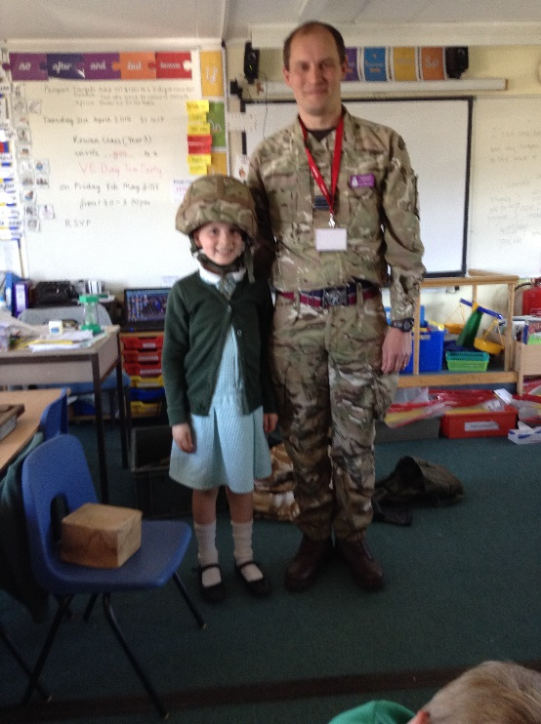
How to be a Modern Father (The Times -February 6 2016)
‘Commando Dad’ by Neil Sinclair
‘This generation of men are expecting and wanting to be more ‘hands-on’ as parents’
Dads need to talk and read to their children- ‘the time a father spends reading with his children is one of the most consistent indicators of their achievement later in life’
Help with homework-even at primary school age: ‘Fathers’ interest in their child’s education is statistically associated with better exam results..’
Notes:
Commando Dad- growing number of parenting books aimed at fathers. Translated into 15 languages- read by Andy Murray and Prince William. Sands are shifting.
Dads use broader vocabulary than mothers-key role in early language development. Fathers stimulate more imaginative discussions when reading bedtime stories. Children do better at school when father is involved- true for two-parent family or divorced dad

Slide 10
Childrens’ Plan (DCSF 2007 research findings):
Highlights the importance of partnership between parents and schools to support children in their learning
Suggests that most children have two main educators- parents and teachers- with parents remaining a major influence on their child’s learning throughout school and beyond.
Parental involvement can be categorised into two broad strands:
Parents involvement in support of the individual child at home
Parents involvement in the life of the school

Slide 11

How can parents get more engaged?
Reinforce the positive ethos that parents are partners in learning
Listen to your child read daily and share books at bedtime
Support maths passport target work and other homework
Volunteer for:
Fundraising with PTA, helping with clubs, helping in class or listening to readers, becoming a Reading Buddy or a governor, attending school performances and assemblies, reinforcing their journeys by taking your child to places to enhance their learning
Attend workshops which support parents
Show an interest in aspects of school life
Notes:
Barriers we find: “Things have changed since I was at school.” “ I hated school”- poor experiences. “I don’t know how to help them.” “It’s the job of the teacher to teach them to read.”

Slide 12
The Impact programme: The background
The programme was set up by Roy Broadfield, an outstanding teacher, in London in 2006 as a pilot to raise achievement in a school where 66% of children did not have English as a first language and 70% children accessed Pupil Premium Grant (FSM)
He designed maths and phonics games to be played at home with parents
The programme was incredibly successful with all the children (not just those who were behind) making significant progress
The programme has gone from strength to strength and is now run in over 300 London schools and 14 other authorities
It proved that when we train parents to be specialist tutors, children’s learning is massively impacted
This is the first programme in the Wiltshire area

Slide 13
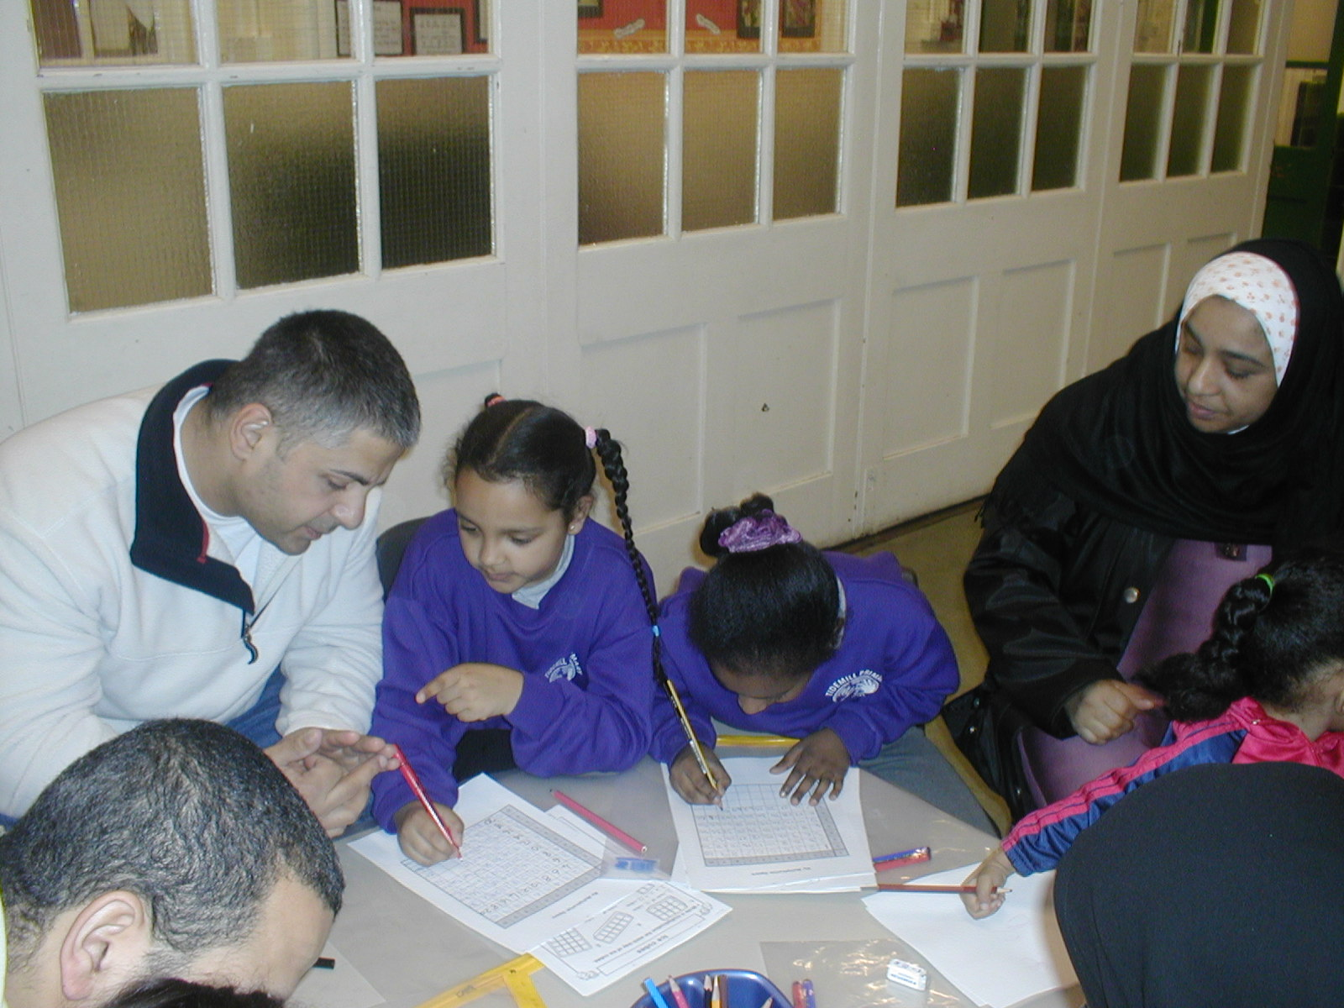
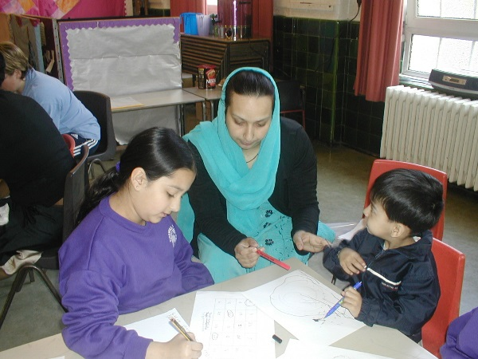
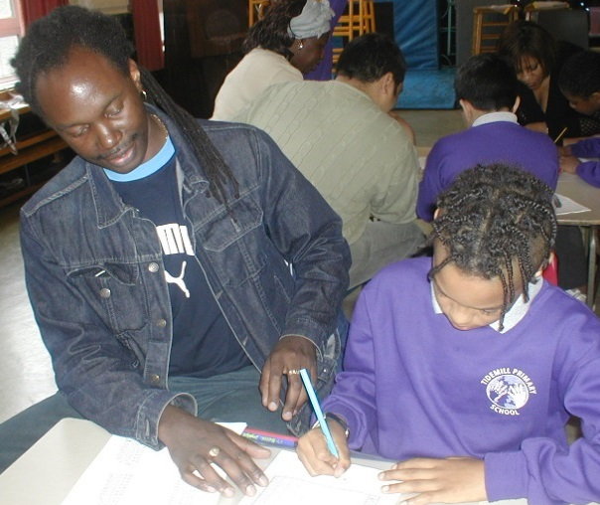
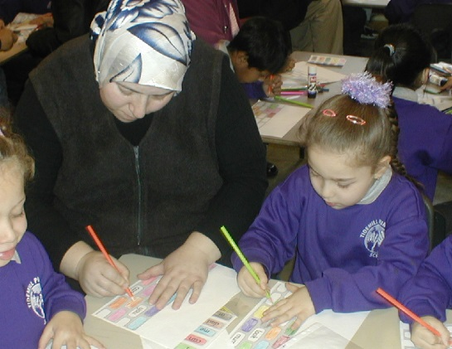

Slide 14
69% of parents do not help children with their homework because
Everything has changed since they were at school at they are not confident in the new methods.
BBC News Report 2006
82% of parents feel unable to help pupils with their homework. 55% of pupils claimed it was worse when parents tried to help.
BBC News Report 2010

Slide 15
The Problem with maths……
“My dad thinks that the way he does maths is easier and better than my ways but he doesn’t understand my ways and his way confuses me.”
Pupil – Catford High School

Slide 16
Year 2 New Curriculum + and -
Read and write numbers to at least 100 in numbers and words.
Recognise the place value of each digit in two-digit number.
Count in steps of 2,3 and 5 from 0, and in tens from any given number.
Compare and order numbers from 0 up to 100; use < and > signs.
Identity, represent… numbers including the number line.
Recall addition and subtraction facts to 20 fluently.
Use place value and number facts to solve problems.
Add and subtract: 2-digit numbers and ones; 2-digit numbers and tens; two 2-digit numbers; adding three 1-digit numbers
Solve problems with addition and subtraction.
Recognise and use the inverse relationship between addition and subtraction and use this to check calculations and solve missing number problems.
Solve simple problems in a practical context involving addition and subtraction of money of the same unit, including giving change

Slide 17


Number bonds to 100
Do we count using our fingers consistently in the same manner?

Slide 18
Number bonds to 100
0 10 20 30 40 50 60 70 80 90 100
100 90 80 70 60 50 40 30 20 10 0

Slide 19
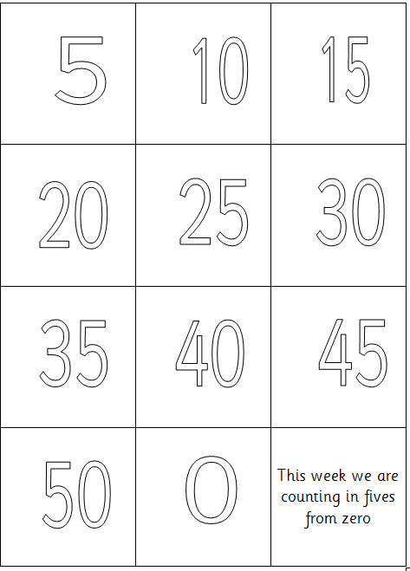

Slide 21
30

Slide 22
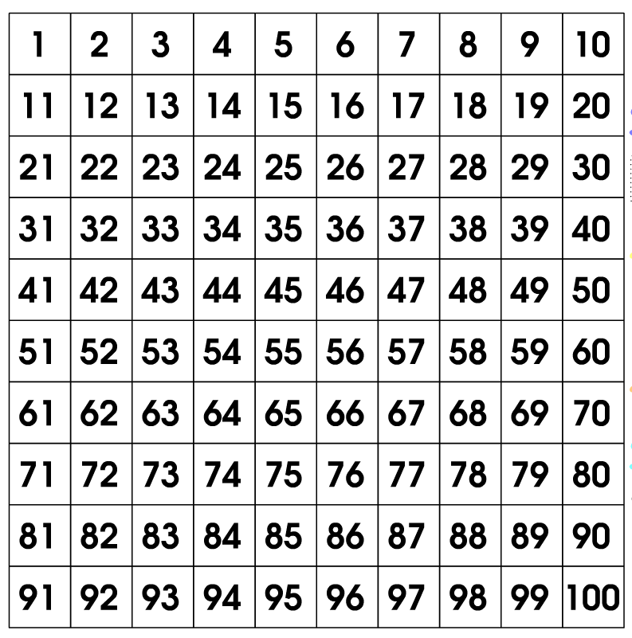
The 100 Square
Can be used for addition, subtraction multiplication and division problems.

Slide 23

200 square

Slide 24
Using your 100 square:
Count in 2s to 20
Count in 3s to 30
Count in 5s to 50

Slide 25
Say the number that is:
Ten more than 22
Ten less than 12
Ten more than 25
Ten less than 30

Slide 26
Greater than, less than…
>

Slide 27





Addition
Addition
23 + 11 =
23 + 11 =
Use of real objects to represent tens and ones.
No carrying.

Slide 28
Now try these:
13 + 16 =
17 + 12 =
15 + 11 =

Slide 29
Subtraction
23 - 11 =
Use of real objects to represent tens and ones.
No carrying.

Slide 30
Now try these:
26 - 12 =
15 - 11 =
16 - 6 =
24 - 14 =

Slide 31
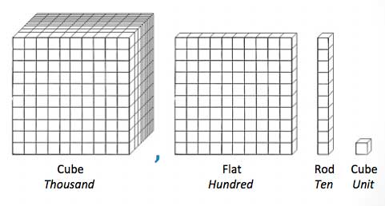
When ready, pupils can move on to using tens rods and ones cubes.
23 + 14 =

Slide 32
Count coins in tens

Slide 33
Adding with coins
20p + 30p

Slide 34

Adding tens and ones

Slide 35


Slide 36
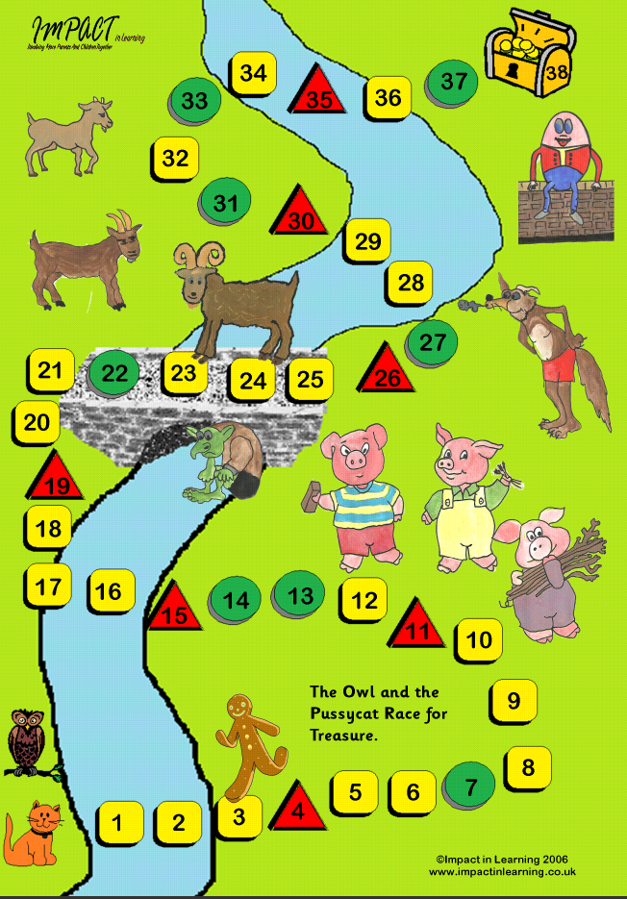

The Owl and Pussycat Game

Slide 37
What is 13 more than 10?
If you got it right move on 3 spaces
Answer
23

Slide 38
Tell your opponent the names of 3 of your friends.

Slide 39
Evaluation
Homework task: play the Owl and Pussycat game every week with the cards given. This week you have addition cards. Each week you will be given different cards.
Complete the game score card every week and stick in to the maths passport book. Please add any comments to help us monitor progress.
Please fill in the evaluation form before you leave- we need to know if you are inspired! If you are, then please complete the Parent View Page on the website.
Perhaps you could show your engagement by being involved more in school events- PTA ? Figsbury Challenge? Cake sales? Reading buddy?
Will you become a Family Learner and encourage your child to become one too?

