Slide 1
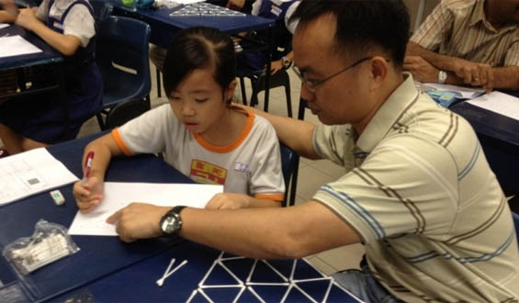

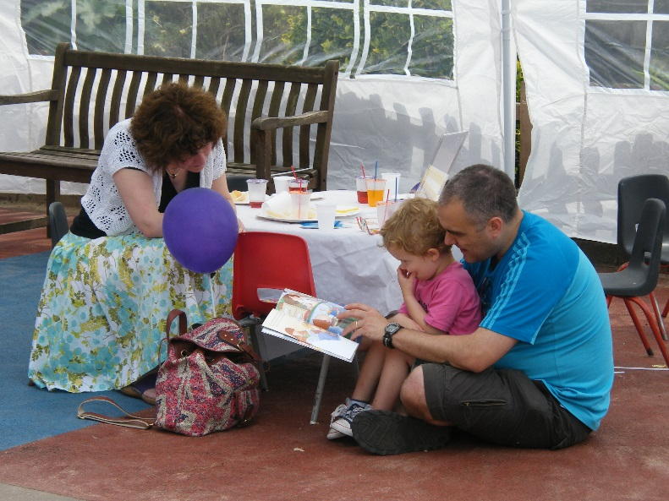

The Impact of Parental Involvement on Pupil Achievement

Slide 2
Aims of these sessions
To encourage all parents attend so that collectively they can discover the importance of parental engagement
To prove to parents and carers how critical their role is in influencing their children
To share general good practice about parental engagement
To encourage parents to support the wider school life
To enthuse parents about home learning
To inspire parents to have high aspirations for their children
To give parents the tools to help their children with writing/maths at home through the Impact in Learning programme

Slide 3

Recent thoughts on parenting
On 11 January 2016 David Cameron announced
a £70 million investment to encourage all parents to attend parenting classes:
‘Children “don’t come with a manual”.
“Is it right that all of us get so little guidance?” he asked. “What about later on, when it comes to good play, communication, behaviour and discipline? We all need more help with this – the most important job we’ll ever have.’’’
I am liaising with a highly recommended Parent Class provider and hope to launch this programme in September

Slide 4

What are the factors affecting educational outcomes?
Child’s characteristics
Family characteristics
School quality
Community
Peer group
Family support services
Parental involvement
Notes:
Family characteristics- what do you want to aspire to? Tim Peake? Peer group- educating children to make the right choices with peer group. Family support services- EWO, ELSA, Health Services, Parenting programmes- all aim to support best outcomes for child. Which ones can we really influence?

Slide 5


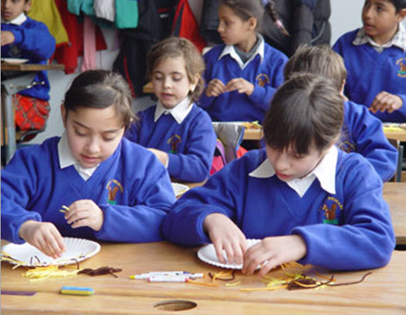
Major factors influencing pupil achievement
Parents’ attitudes and behaviours
Child’s attitudes and behaviours
Material resources
“What parents do is more important than who they are”
Notes:
Parents model importance of school and have continual high aspirations for children. Material resources is low key influence- chn in relative poverty in say Africa where education is valued and often view schooling as an opportunity to get out of poverty

Slide 6
Professor Charles Desforges
A well-respected independent educational consultant
Awarded an OBE
Special interests in teaching, learning and parental involvement
Research adviser to government bodies here and overseas
He carried out the largest co-ordinated programme of social research ever mounted in the UK
Notes:
Ted Wragg was an advocate of warmth, humour and humanity in the classroom and defended these ideals with passion against a narrow functional approach to learning; he opposed political interference and wrote extensively in the Times Educational Supplement and The Guardian

Slide 7

Notes:
Choose a different school and your child could achieve 5% better or worse but parental engagement in child’s learning can mean your child achieves 30% more (or less). We often consider what a specific child could have achieved with the right parental involvement

Slide 8


“The most important finding is that parental involvement in the form of ‘at-home good parenting’ has a significant positive effect on children’s achievement.
In the primary age range the impact caused by different levels of parental involvement is much bigger than differences associated with variations in the quality of schools.
The scale of the impact is evident across all social classes and all ethnic groups.”
(THE IMPACT OF PARENTAL INVOLVEMENT, PARENTAL SUPPORT AND FAMILY EDUCATION ON PUPIL ACHIEVEMENT AND ADJUSTMENT:A LITERATURE REVIEW by Professor Charles Desforges with Alberto Abouchaar)

Slide 9
Effects of parents v effect of schools
(2002 Sacker et al)
Achievement at | Parental effect | School effect
Age 7 | 29% | 5%
Age 11 | 27% | 21%
Age 16 | 14% | 51%
Notes:
Showing that at age of 7 parents are 6x more influential than teachers. We can help you so that you can influence your child, then worst parents changing into the best parents can make 1/3 of a difference in their child’s attainment. Key is age- need to put in the support early on. So extrapolating parent with a preschool child has 100% influence, then by year 3 has 29% influence, then at Year R and Year 1 influence has even greater impact. Leverage parents have swamps the leverage we as teachers have.

Slide 10


The Impact of Parents’ Involvement on Children’s Education (DSCF 2008 research findings):
Parental involvement in children’s education from an early age has a significant effect on educational achievement and continues to do so into adolescence and into adulthood
Family learning can also provide a range of benefits for parents and children including improvements in reading, writing and numeracy as well as greater parental confidence in helping their child at home
The quality and content of fathers’ involvement matters more than the quantity of time fathers spend with their children
Notes:
Parental involvement: Early years-parent is educator but through school joint responsibility. Family learning- what we will be doing together- child and parent learning together. Video showed workshop with parents and children learning about maths together- we are focusing on Literacy.

Slide 11
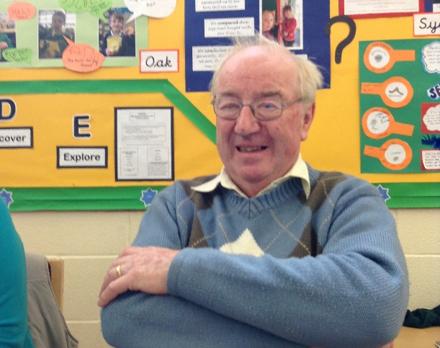
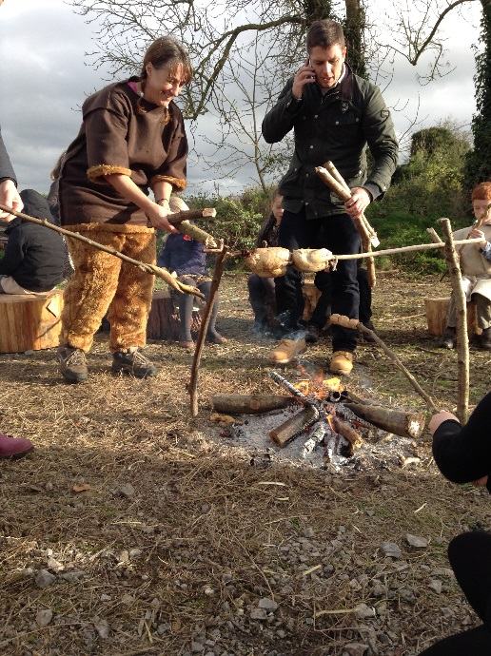
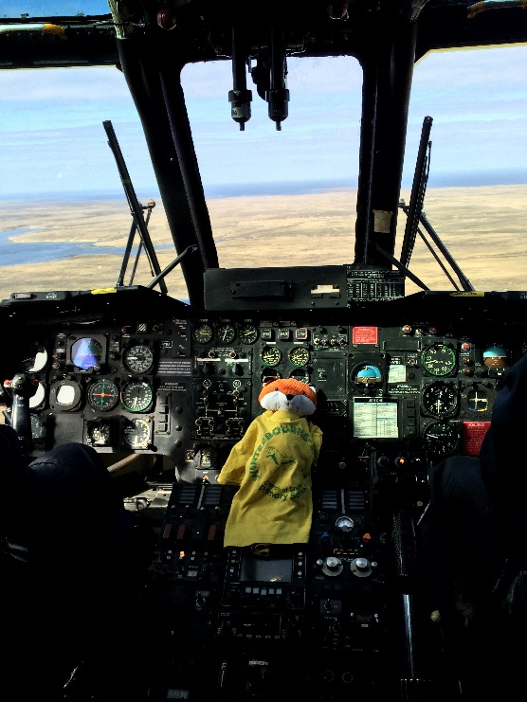
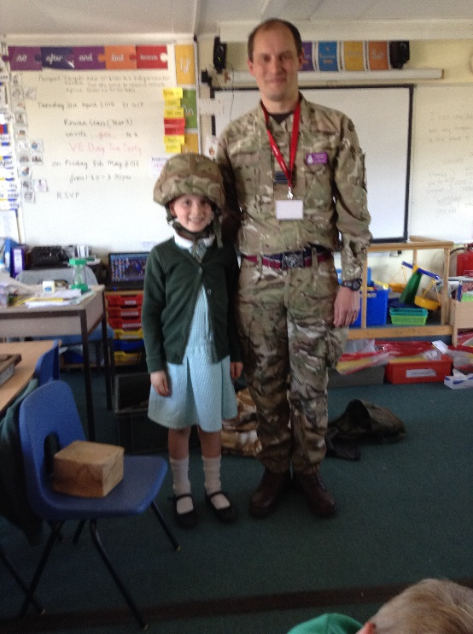
How to be a Modern Father (The Times -February 6 2016)
‘Commando Dad’ by Neil Sinclair
‘This generation of men are expecting and wanting to be more ‘hands-on’ as parents’
Dads need to talk and read to their children- ‘the time a father spends reading with his children is one of the most consistent indicators of their achievement later in life’
Help with homework-even at primary school age: ‘Fathers’ interest in their child’s education is statistically associated with better exam results..’
Notes:
Commando Dad- growing number of parenting books aimed at fathers. Translated into 15 languages- read by Andy Murray and Prince William. Sands are shifting.
Dads use broader vocabulary than mothers-key role in early language development. Fathers stimulate more imaginative discussions when reading bedtime stories. Children do better at school when father is involved- true for two-parent family or divorced dad

Slide 12
Childrens’ Plan (DCSF 2007 research findings):
Highlights the importance of partnership between parents and schools to support children in their learning
Suggests that most children have two main educators- parents and teachers- with parents remaining a major influence on their child’s learning throughout school and beyond.
Parental involvement can be categorised into two broad strands:
Parents involvement in support of the individual child at home
Parents involvement in the life of the school

Slide 13

How can parents get more engaged?
Reinforce the positive ethos that parents are partners in learning
Listen to your child read daily and share books at bedtime
Support maths passport target work and other homework
Volunteer for:
Fundraising with PTA, helping with clubs, helping in class or listening to readers, becoming a Reading Buddy or a governor, attending school performances and assemblies, reinforcing their journeys by taking your child to places to enhance their learning
Attend workshops which support parents
Show an interest in aspects of school life
Notes:
Barriers we find: “Things have changed since I was at school.” “ I hated school”- poor experiences. “I don’t know how to help them.” “It’s the job of the teacher to teach them to read.”

Slide 14
The Impact programme: The background
The programme was set up by Roy Broadfield, an outstanding teacher, in London in 2006 as a pilot to raise achievement in a school where 66% of children did not have English as a first language and 70% children accessed Pupil Premium Grant (FSM)
He designed maths and phonics games to be played at home with parents
The programme was incredibly successful with all the children (not just those who were behind) making significant progress
The programme has gone from strength to strength and is now run in over 300 London schools and 14 other authorities
It proved that when we train parents to be specialist tutors, children’s learning is massively impacted
This will be the first programme in the Wiltshire area

Slide 15
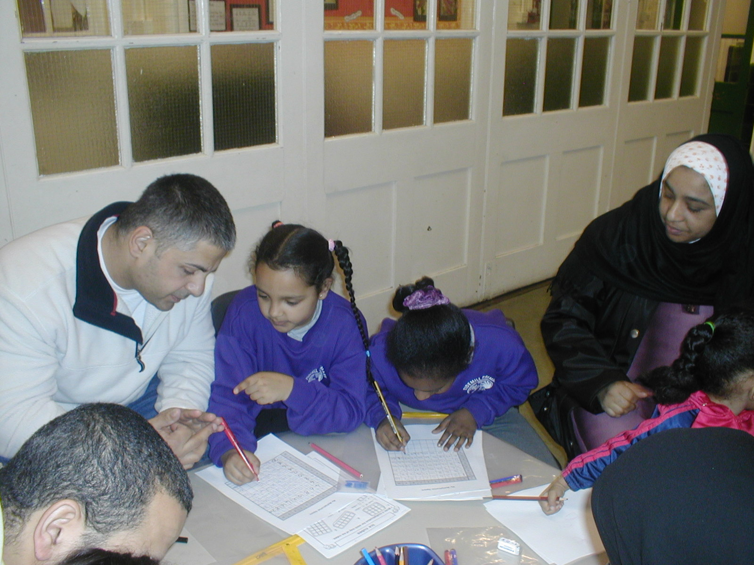
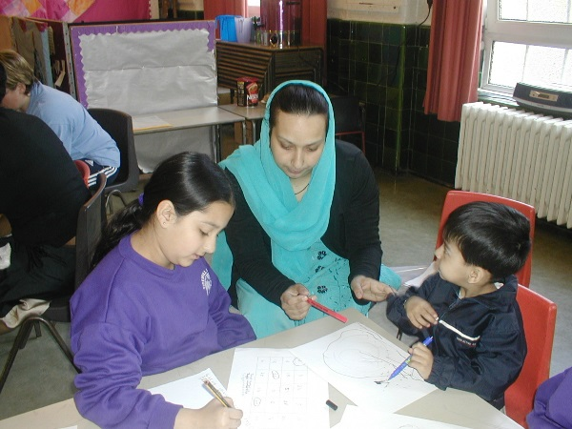

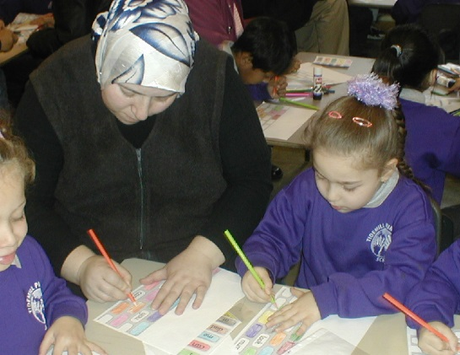

Slide 16
In this workshop we aim to:
Encourage partnership
Demonstrate
Share tools
Offer tools for use at home
Support
Improve (5 week programme)

Slide 17

©Impact in Learning 2006

Slide 18

Handwriting
Last year we introduced cursive handwriting throughout the school
Although it may seem awkward at this stage, it has been proven to help spelling and enables the quicker formation of a neat script
Please encourage accurate handwriting; it is really key to spend time ensuring each letter is correctly formed as poor formation can become a habit which is very hard to correct further up the school
Check your child’s pencil grip is correct
There are a number of worksheets in your pack to guide you

Slide 19


Slide 22


Slide 23
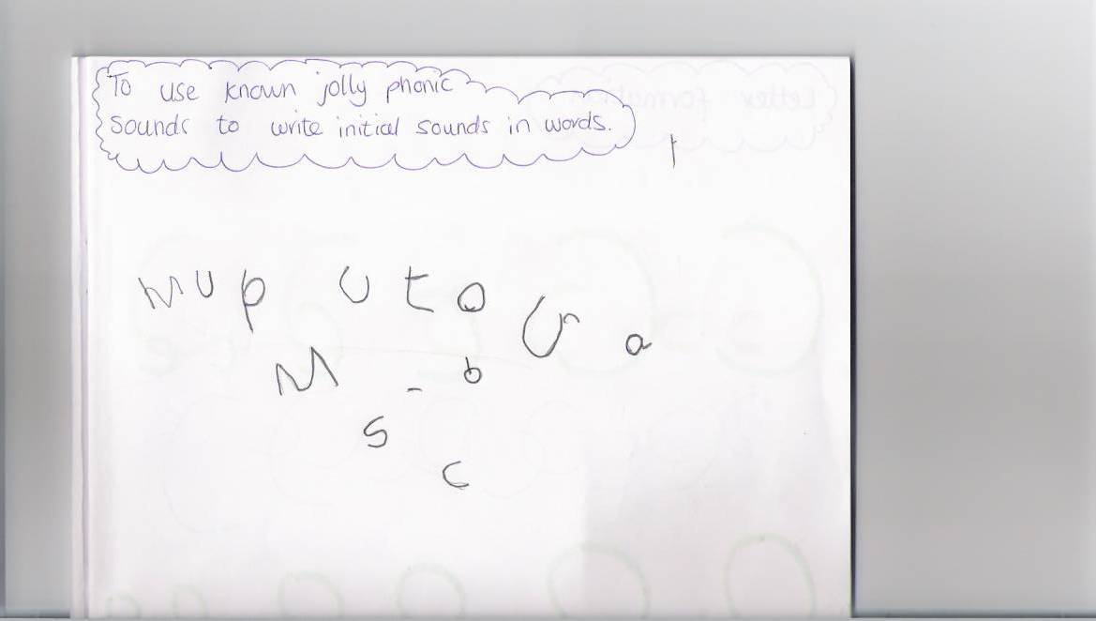
Child one week one

Slide 24

Child one week six

Slide 25
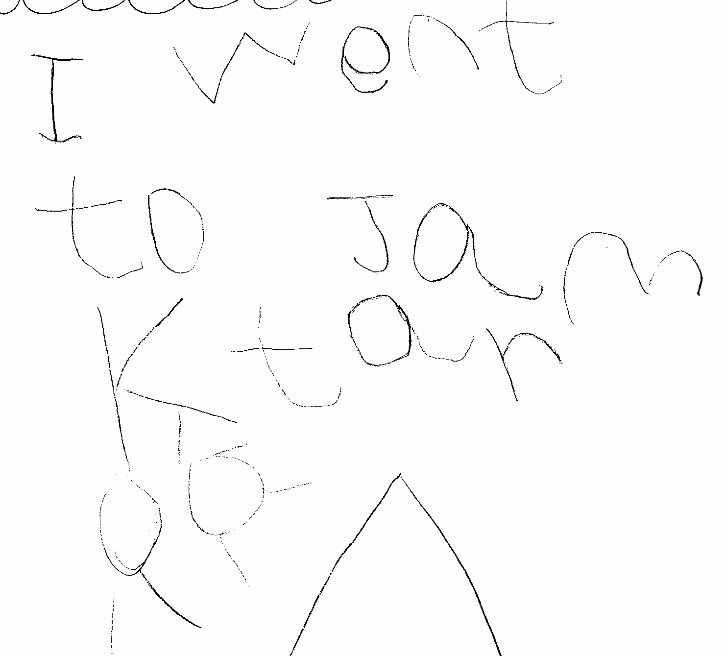
Child two week one

Slide 26
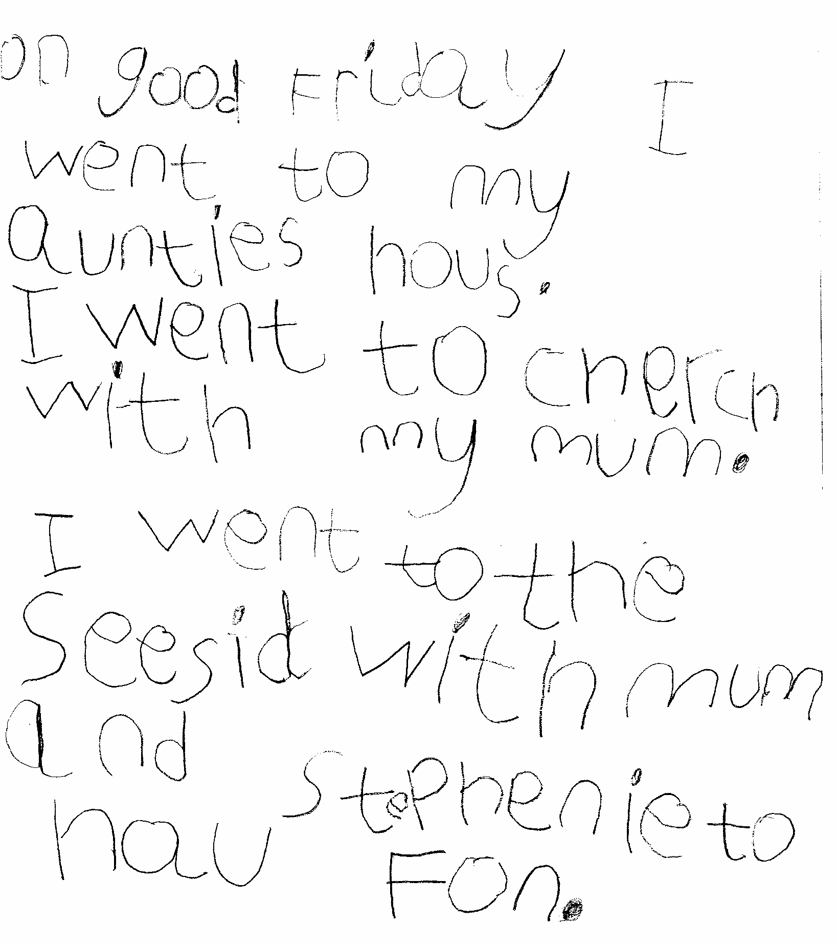
Child two week six

Slide 27
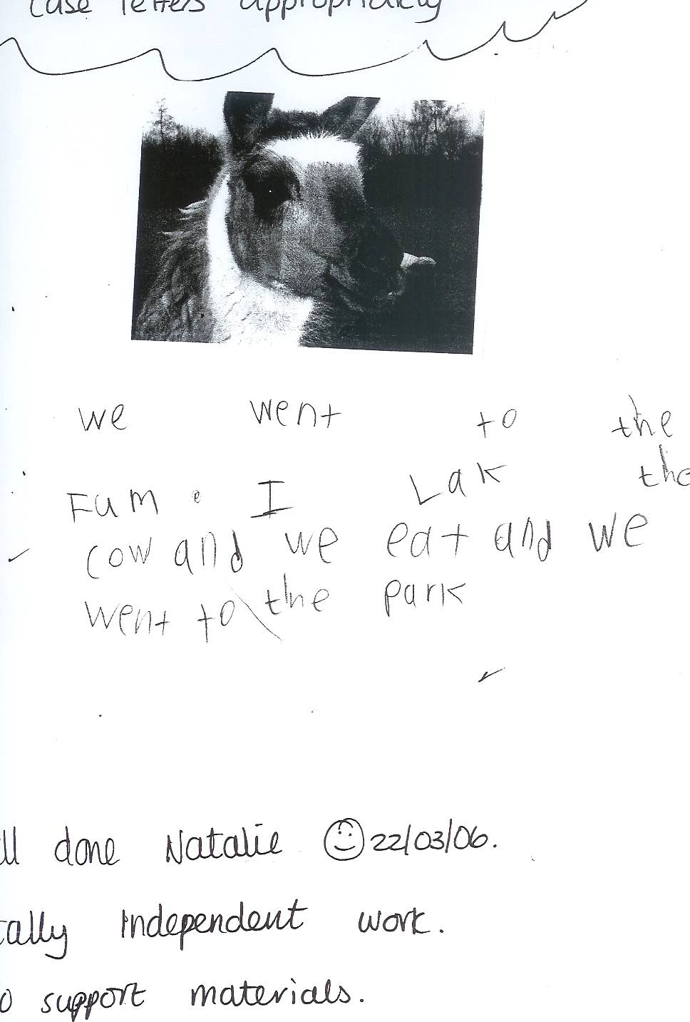
Child three week one

Slide 28
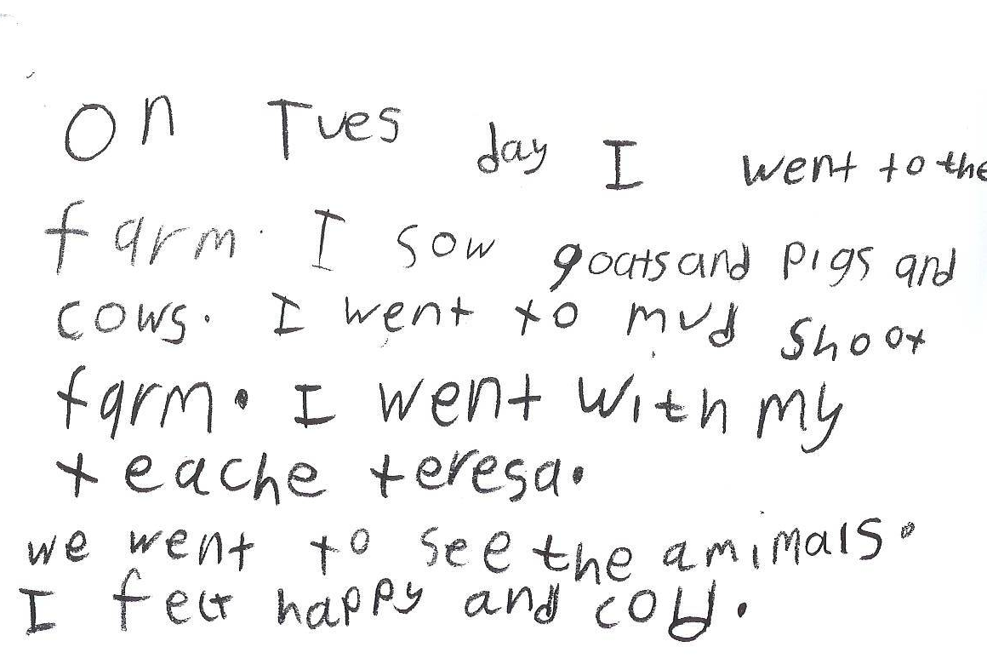
Child three week six

Slide 29
Evaluation
This first piece of work needs to be completed at home at handed in to Mrs Mac on Friday
Homework tasks: one per week with the last one to be done over Easter
Please fill in the evaluation form before you leave- we need to know if you are inspired! If you are, then please complete the Parent View Page on the website
Let us know if we can offer any other workshops
Could you encourage your child to write a diary over the Easter holidays?
Perhaps you could show your engagement by being involved more in school events- PTA ? Figsbury Challenge? Cake sales? Reading buddy?
Will you become a Family Learner and encourage your child to become one too?

