Slide 2
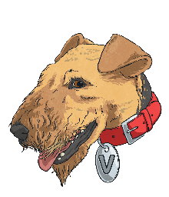
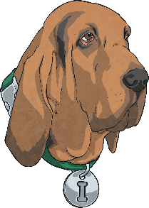
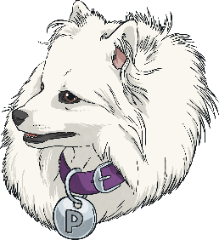
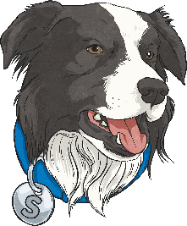
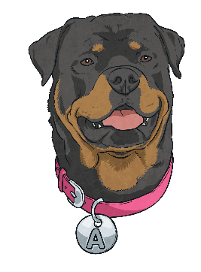
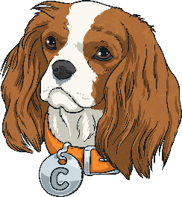
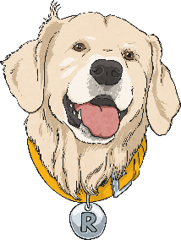
Who Are the Totally Pawsome Reading Gang?
The Totally Pawsome Reading Gang is a group of clever canines who each help with one of the reading content domains.
Click on each dog to find out who they are and what they do.
Vocabulary Victor
Inference Iggy
Summarising Sheba
Predicting Pip
Rex Retriever
Arlo the Author
Cassie the Commentator

Slide 3
Who Are the Totally Pawsome Reading Gang?
The Totally Pawsome Reading Gang is a group of clever canines who each help with one of the reading content domains.
Click on each dog to find out who they are and what they do.
Vocabulary Victor
Inference Iggy
Summarising Sheba
Predicting Pip
Rex Retriever
Arlo the Author
Cassie the Commentator

Slide 4

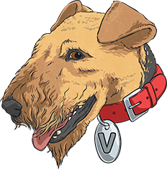

What Does Vocabulary Victor Do?
Vocabulary Victor helps with content domain 2a:
Give/explain the meaning of words in context.
This means that he is there to help you to work out the meaning of words you don’t know.
He helps you to do this by looking at the words or
phrases you’re unsure of in context.
This means using the story so far, the sentences
around the words and what you already know about
the plot to figure out what the words must mean.

Slide 5
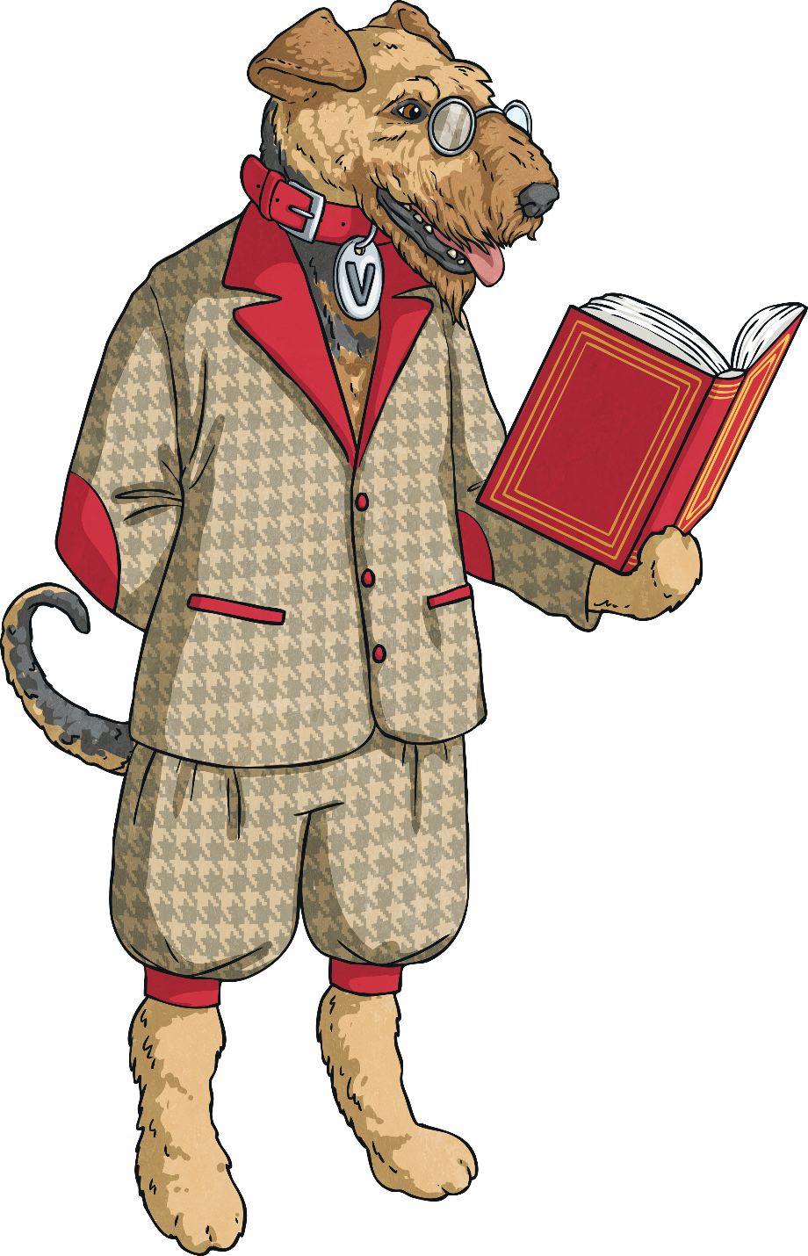
What Might Vocabulary Victor Ask?
Vocabulary Victor might ask questions like these:
What does this word tell us about the character/setting/atmosphere?
Look at the sentence/passage and circle a word/phrase that means the same as…
Which word/phrase gives us the impression that the main character is…?
Why did the author use this word to describe…?
What might that mean?
What do you think the author is saying when they write…?

Slide 6
Who Are the Totally Pawsome Reading Gang?
The Totally Pawsome Reading Gang is a group of clever canines who each help with one of the reading content domains.
Click on each dog to find out who they are and what they do.
Vocabulary Victor
Inference Iggy
Summarising Sheba
Predicting Pip
Rex Retriever
Arlo the Author
Cassie the Commentator

Slide 7
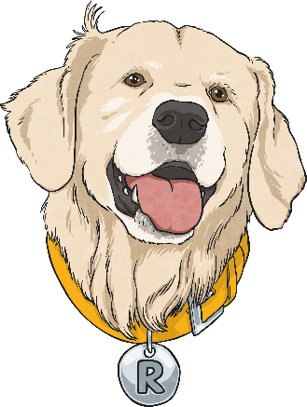
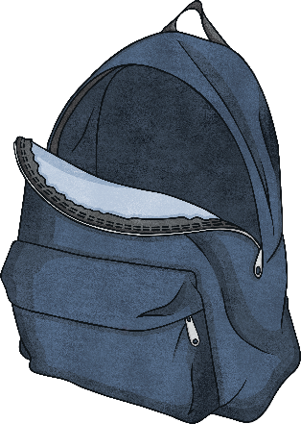
What Does Rex Retriever Do?
Rex Retriever helps with content domain 2b:
Retrieve and record information/identify key details from fiction and non-fiction.
This means that he is there to help you to find key pieces of information within the text you are reading.
He helps you to do this by looking through the text for a specific answer.
With Rex Retriever questions, the answer you are looking for is always in the text somewhere…
you just have to find and retrieve it!

Slide 8
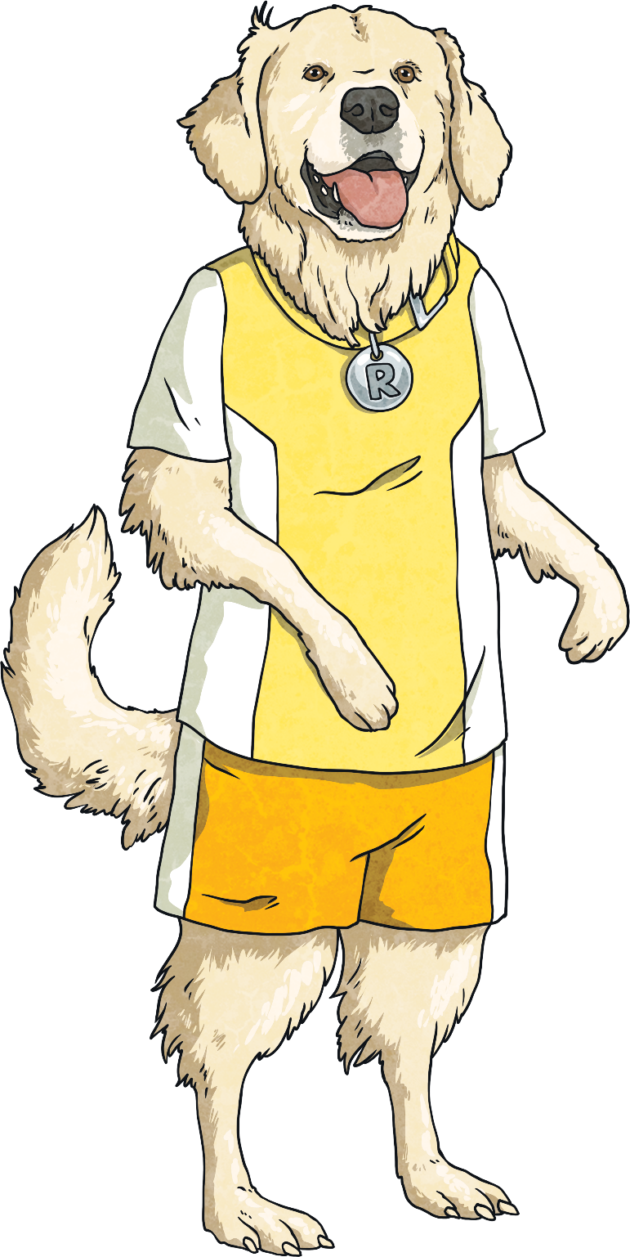
What Might Rex Retriever Ask?
Rex Retriever might ask questions like these:
What is the name of the main character?
Which part of the text tells you…?
Where/when is this story set?
How do you know?
How does the main character behave/speak/look?
What do you think is happening
in this part of the story?
Who is telling this story? How do you know?

Slide 9
Who Are the Totally Pawsome Reading Gang?
The Totally Pawsome Reading Gang is a group of clever canines who each help with one of the reading content domains.
Click on each dog to find out who they are and what they do.
Vocabulary Victor
Inference Iggy
Summarising Sheba
Predicting Pip
Rex Retriever
Arlo the Author
Cassie the Commentator

Slide 10


What Does Predicting Pip Do?
Predicting Pip helps with content domain 2e:
Predict what might happen from details
stated and implied.
This means that she is there to help you to try to make a logical and reasonable guess about what could happen next.
She helps you to do this by getting you to look at what has already happened, what the characters may have hinted is coming up or what has been implied by the author’s use of language.
If someone brought a cake lit with candles into a party, what would logically happen next?

Slide 11
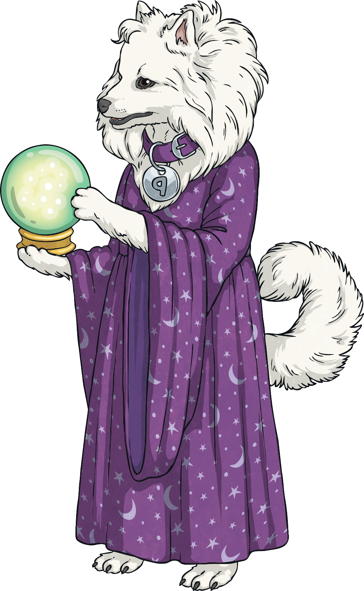
What Might Predicting Pip Ask?
Predicting Pip might ask questions like these:
How do you think this story might end?
Based on what you’ve read, what do you think might happen next?
What clues does the front cover give us about the contents of this book?
How would someone you know react if they were in this situation?
Do you think that this character will change their behaviour in future? Why?
What do you think is likely to happen when…?

Slide 12
Who Are the Totally Pawsome Reading Gang?
The Totally Pawsome Reading Gang is a group of clever canines who each help with one of the reading content domains.
Click on each dog to find out who they are and what they do.
Vocabulary Victor
Inference Iggy
Summarising Sheba
Predicting Pip
Rex Retriever
Arlo the Author
Cassie the Commentator

Slide 13


What Does Inference Iggy Do?
Inference Iggy helps with content domain 2d:
Make inferences from the text/explain and justify inferences with evidence from the text.
This means that he is there to help you to pick up ideas from the text that are not always written in the text itself.
He helps you to do this by getting you to read the text as if you are a detective. You’re not looking for what is there – you’re looking for what is meant by it.
For example, if the text says ‘Jenni’s face was red –
she wrinkled her brow and began to shout’, what
could you infer about how Jenni feels?

Slide 14
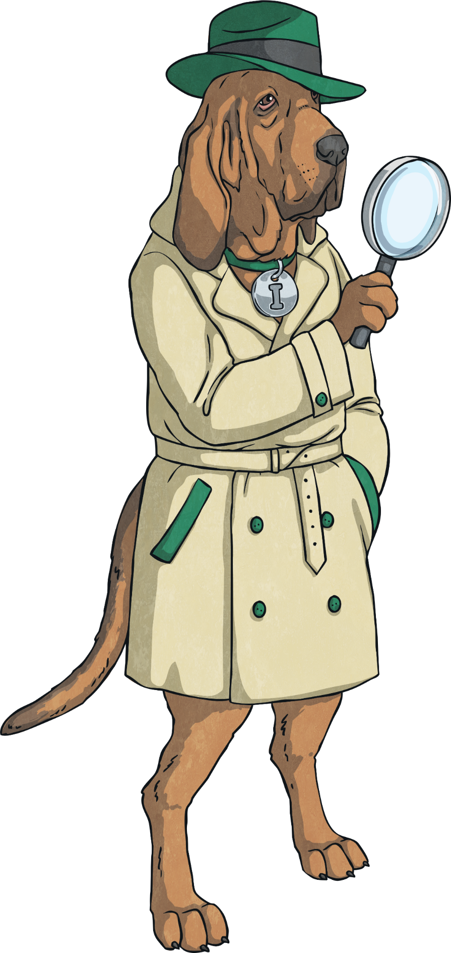
What Might Inference Iggy Ask?
Inference Iggy might ask questions like these:
Why did the character behave like this?
What makes you think…?
Give evidence to support your answer.
What impression are we given about…? Why?
How does this character feel about
the situation? How do you know?
Which character would you most like to meet?
Explain why.
Why is… important? Explain your answer.

Slide 15
Who Are the Totally Pawsome Reading Gang?
The Totally Pawsome Reading Gang is a group of clever canines who each help with one of the reading content domains.
Click on each dog to find out who they are and what they do.
Vocabulary Victor
Inference Iggy
Summarising Sheba
Predicting Pip
Rex Retriever
Arlo the Author
Cassie the Commentator

Slide 16
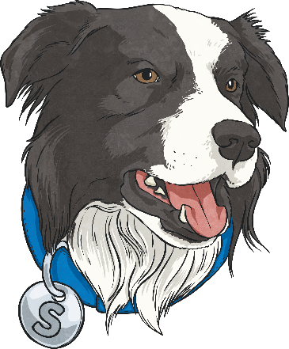
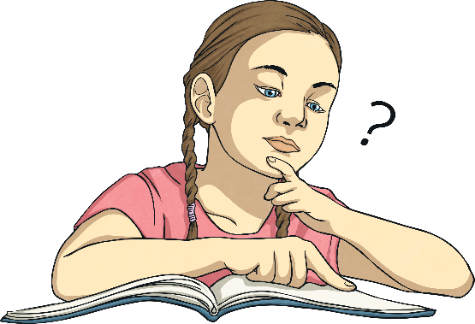
What Does Summarising Sheba Do?
Summarising Sheba helps with content domain 2c:
Summarise main ideas from more
than one paragraph.
This means that she is there to help you to sum up what you’ve read.
She helps you to do this by reading the text, picking out the key points that are really important and giving a quick run down of the text’s main ideas.
Imagine that you’ve read a book and have to send your friend a message about the plot – which key points
would you tell them and which would you leave out?

Slide 17
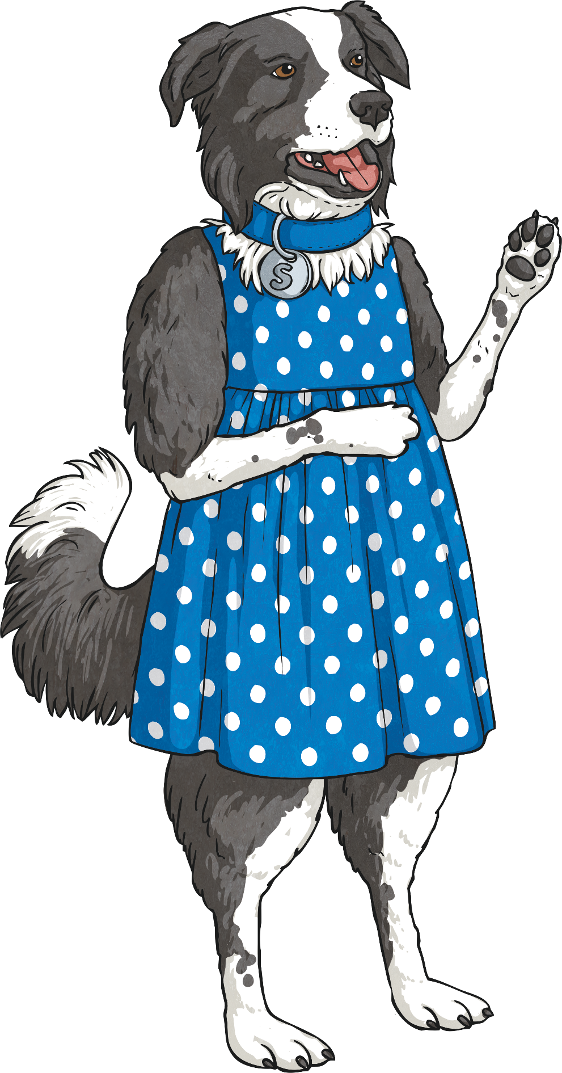
What Might Summarising Sheba Ask?
Summarising Sheba might ask questions like these:
How would you sum up…?
Can you describe what happened in this chapter?
What is the main theme/argument/message of this paragraph?
Write a new blurb for this story using 20 words or fewer.
Can you describe what happened in three short sentences?
What is the most important message in this book?

Slide 18
Who Are the Totally Pawsome Reading Gang?
The Totally Pawsome Reading Gang is a group of clever canines who each help with one of the reading content domains.
Click on each dog to find out who they are and what they do.
Vocabulary Victor
Inference Iggy
Summarising Sheba
Predicting Pip
Rex Retriever
Arlo the Author
Cassie the Commentator

Slide 19


What Does Arlo the Author Do?
Arlo the Author helps with content domain 2g:
Identify/explain how meaning is enhanced through choice of words and phrases.
This means that he is there to help you to spot examples of ambitious vocabulary and figurative language within the text.
When you find them, Arlo helps you to think about why
the author made those vocabulary choices and how
they give a certain meaning to the text.
For example, an author could say that the water in a lake was still and reflective. However, for effect, they could describe the water as ‘like a sheet of glass’.

Slide 20
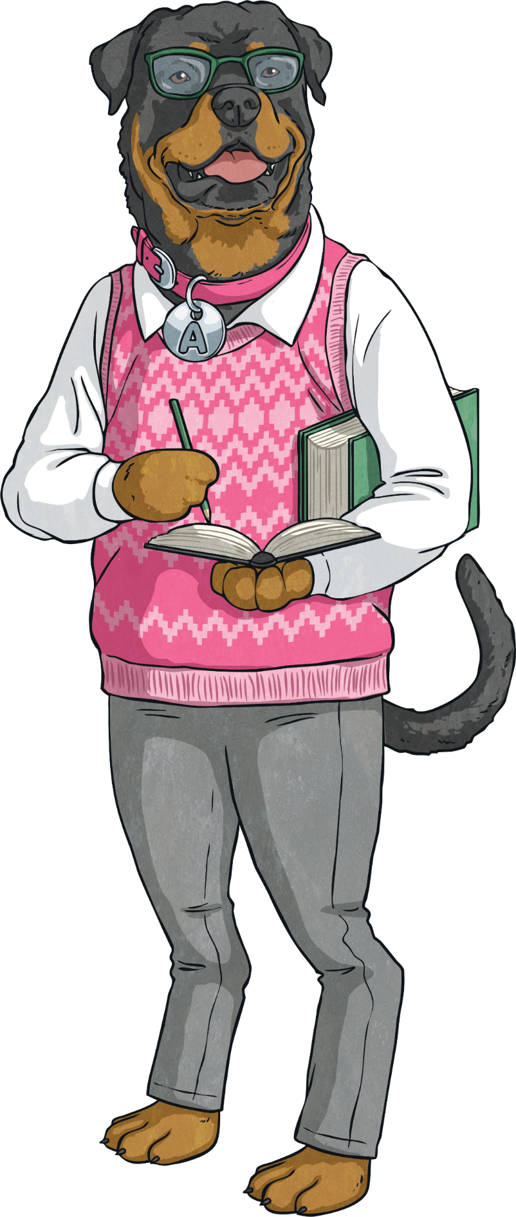
What Might Arlo the Author Ask?
Arlo the Author might ask questions like these:
What does this word tell us about the character/setting/atmosphere?
How has the author’s choice of words created a feeling of…?
Look at that phrase which implies that the character/setting/atmosphere is…
Look for a simile/metaphor in the text.
How does this add meaning?
Find and copy an example of personification from the text. Why is it used?
Why did the author choose this particular verb/adjective/adverb?

Slide 21
Who Are the Totally Pawsome Reading Gang?
The Totally Pawsome Reading Gang is a group of clever canines who each help with one of the reading content domains.
Click on each dog to find out who they are and what they do.
Vocabulary Victor
Inference Iggy
Summarising Sheba
Predicting Pip
Rex Retriever
Arlo the Author
Cassie the Commentator

Slide 22

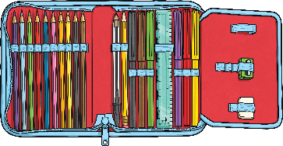
What Does Cassie the Commentator Do?
Cassie the Commentator helps with content domains 2f and 2h:
2f: Identify/explain how information/narrative content is related and contributes to meaning as a whole.
2h: Make comparisons within the text.
This means that she is there to help you to do two things:
explain how certain parts of a text build or change an overall message or meaning;
say how characters or events within the story are similar to or different from each other or how a single character changes over the course of a story.

Slide 23
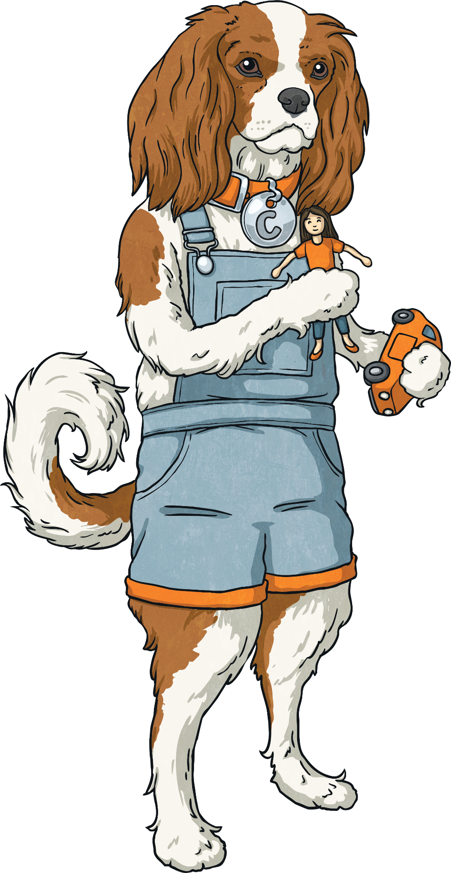
What Might Cassie the Commentator Ask?
Cassie the Commentator might ask questions like these:
Compare one character to another.
How are they different or similar?
How are the settings within the story
similar or different?
Who has the author written this text for? Why?
How has this character changed during the text?
Compare how the characters react to this situation.
Who deals with it best?
What is the most thought-provoking moment of the story?

Slide 24
Who Are the Totally Pawsome Reading Gang?
The Totally Pawsome Reading Gang is a group of clever canines who each help with one of the reading content domains.
Click on each dog to find out who they are and what they do.
Vocabulary Victor
Inference Iggy
Summarising Sheba
Predicting Pip
Rex Retriever
Arlo the Author
Cassie the Commentator

