Slide 2


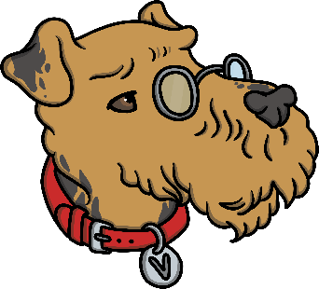

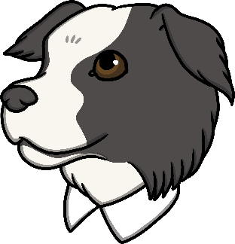
Who Are the Totally Pawsome Reading Gang?
The Totally Pawsome Reading Gang is a group of clever canines who each help with one of the reading content domains.
Click on each dog to find out who they are and what they do.
Vocabulary Victor
Rex Retriever
Predicting Pip
Inference Iggy
Sequencing Suki

Slide 3



What Does Vocabulary Victor Do?
Vocabulary Victor helps with content domain 1a:
Draw on knowledge of vocabulary to understand texts.
This means that he is there to help you to think about the words the author uses.
He might help you to:
work out what words mean;
ask you to find words that the author has used;
ask you to give another word which means the same
as one of the author’s choices.

Slide 4

What Might Vocabulary Victor Ask?
Vocabulary Victor might ask questions like these:
What does this word tell us about…?
Which word did the author use to describe…?
Can you think of another way of writing…?
Can you find any adjectives in the text?
How can we work out
what this word might mean?
Why did the author write this word
in capital letters?

Slide 5
Who Are the Totally Pawsome Reading Gang?
The Totally Pawsome Reading Gang is a group of clever canines who each help with one of the reading content domains.
Click on each dog to find out who they are and what they do.
Vocabulary Victor
Rex Retriever
Predicting Pip
Inference Iggy
Sequencing Suki

Slide 6


What Does Rex Retriever Do?
Rex Retriever helps with content domain 1b:
Identify/explain key aspects of fiction and
non-fiction texts, such as characters, events, titles and information.
This means that he is there to help you to answer questions by finding the answer in the text.
He might ask you:
what the characters are called;
what the characters do;
what the name of the chapter is;
what you have learnt about a particular topic.

Slide 7
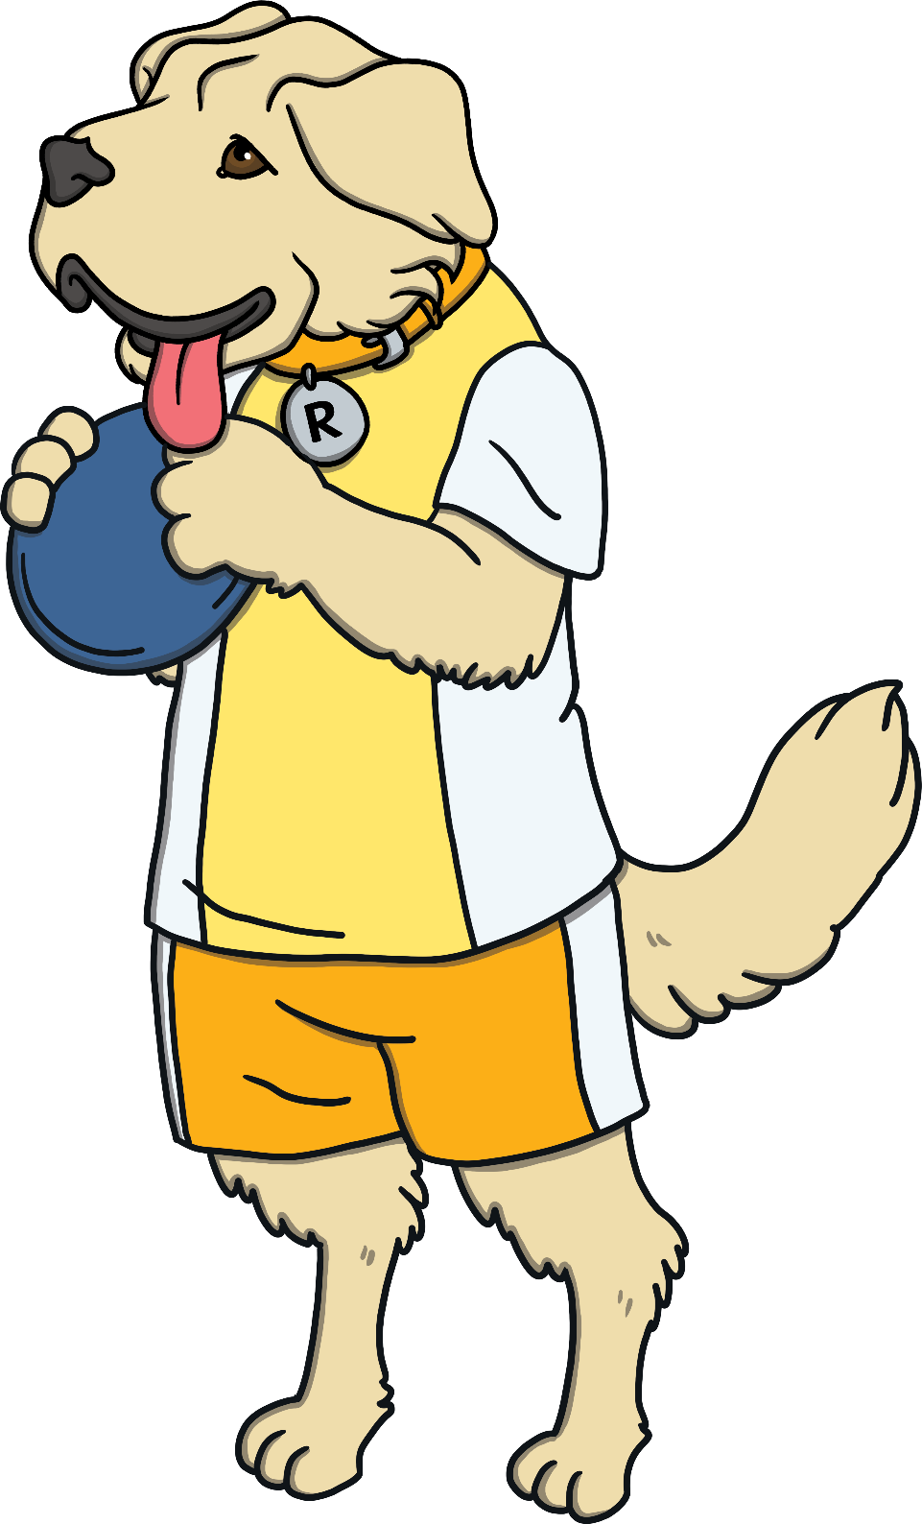
What Might Rex Retriever Ask?
Rex Retriever might ask questions like these:
Where is the story set?
Who is the main character in the story?
How is the dilemma resolved?
Can you tell me one fact you have found out in this text about…?
Where in this book could I look if I wanted
to know more about…?
Which part of the story did you like the most? Why?

Slide 8
Who Are the Totally Pawsome Reading Gang?
The Totally Pawsome Reading Gang is a group of clever canines who each help with one of the reading content domains.
Click on each dog to find out who they are and what they do.
Vocabulary Victor
Rex Retriever
Predicting Pip
Inference Iggy
Sequencing Suki

Slide 9


What Does Predicting Pip Do?
Predicting Pip helps with content domain 1e:
Predict what might happen on the basis
of what has been read so far.
This means that she is there to
help you to see into the future.
She will try to help you to:
work out what might happen next based
on what you have already read and what
you know about that type of text.

Slide 10
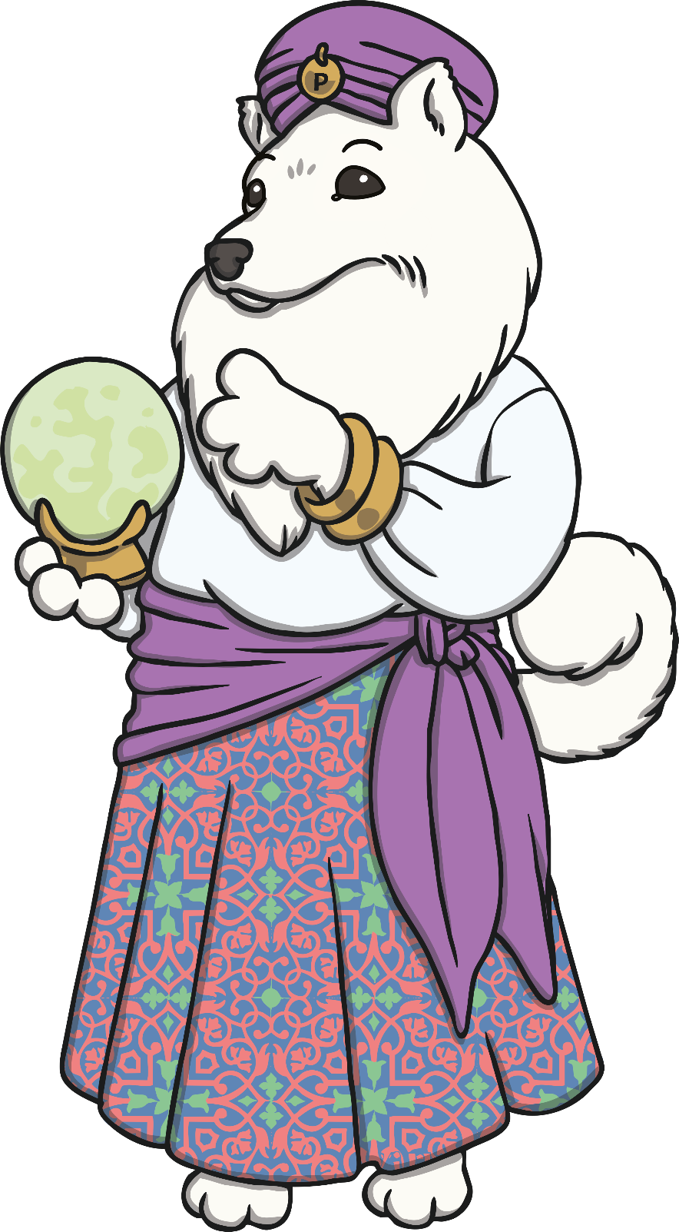
What Might Predicting Pip Ask?
Predicting Pip might ask questions like these:
What do you think will happen next?
What do you think the character will say in reply to that?
What do you think that this book will be about?
How do you think the story will end?
Do you think that this story will end in the same way as another story you know?
Can you draw what you think might happen next?

Slide 11
Who Are the Totally Pawsome Reading Gang?
The Totally Pawsome Reading Gang is a group of clever canines who each help with one of the reading content domains.
Click on each dog to find out who they are and what they do.
Vocabulary Victor
Rex Retriever
Predicting Pip
Inference Iggy
Sequencing Suki

Slide 12

What Does Inference Iggy Do?
Inference Iggy helps with content domain 1d:
Make inferences from the text.
This means that he is there to help you to hunt for clues in the text.
These clues might help you to work out how someone is feeling, why somebody did something or why something is happening.
The two types of question that Inference Iggy likes to ask most are:
why?
how do you know?

Slide 13

What Might Inference Iggy Ask?
Inference Iggy might ask questions like these:
What do you think the author meant when…?
How do you think this character is feeling? Why do you think that?
What effect did the author want to create by…?
Can you find words which show how the character feels about…?
Why do you think the author uses this particular word?
How do you know that the character is feeling…?

Slide 14
Who Are the Totally Pawsome Reading Gang?
The Totally Pawsome Reading Gang is a group of clever canines who each help with one of the reading content domains.
Click on each dog to find out who they are and what they do.
Vocabulary Victor
Rex Retriever
Predicting Pip
Inference Iggy
Sequencing Suki

Slide 15

What Does Sequencing Suki Do?
Sequencing Suki helps with content domain 1c:
Identify and explain the
sequence of events in texts.
This means that she is there to help you to think about the order things happen in.
She might ask you:
to put different events from the text into the order
that they happened;
to match events to the day or time they happened;
what happened first or last.

Slide 16
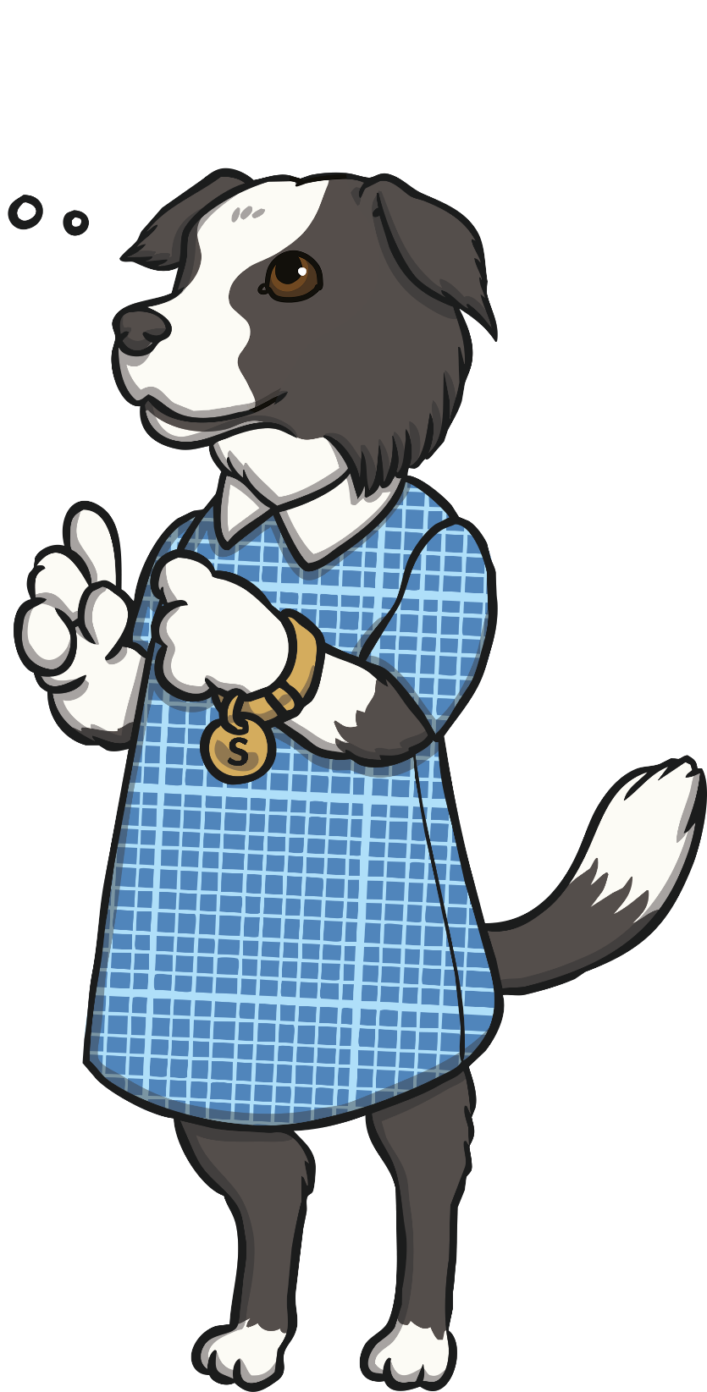
What Might Sequencing Suki Ask?
Sequencing Suki might ask questions like these:
Who do we meet first in this story?
What is the last step of these instructions?
Can you put these sentences into
the order they happened in?
Can you use 20 words to sum up what happened in this story?
Can you draw a picture to show what happened in the middle of the story?
Do I need to read this text in the order
it is written? What happens if I don’t?

