Slide 1
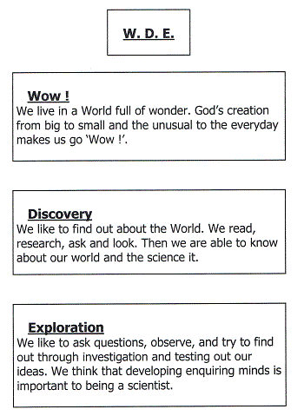
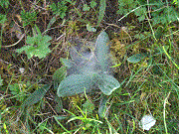
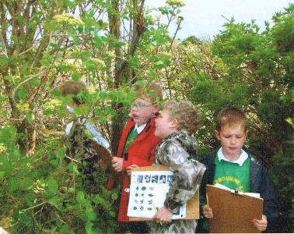
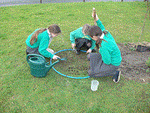




Welcome to Science at
Winterbourne Earls C of E Primary {WBE}
Science
Our School
Here at WBE our Science is all about WDE
There is science
everywhere ...
all around us.
I love to find out.
To see what will happen if…
*Practical + Doing. *Challenging. *Enjoyment +Learning through ‘Fun’.
*Wow + Unexpected. *Relevant + Linked *Exploration +Discovering our World.
*Ownership and Children planning our own. *Time to – try, test, repeat, review, redo.
PSQM: We are rather proud that, through the children’s hard work and learning in Science, the school has recently been awarded the Primary Science Quality Mark, Gold Standard.
PSTT/C: We are delighted to work very closely with the Primary Science Teaching Trust. Being a PST College Fellow’s school has brought tremendous benefit to us and also opportunities to the local area.

Slide 2
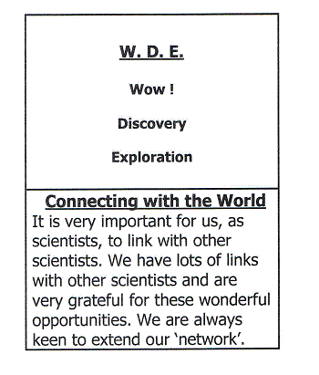
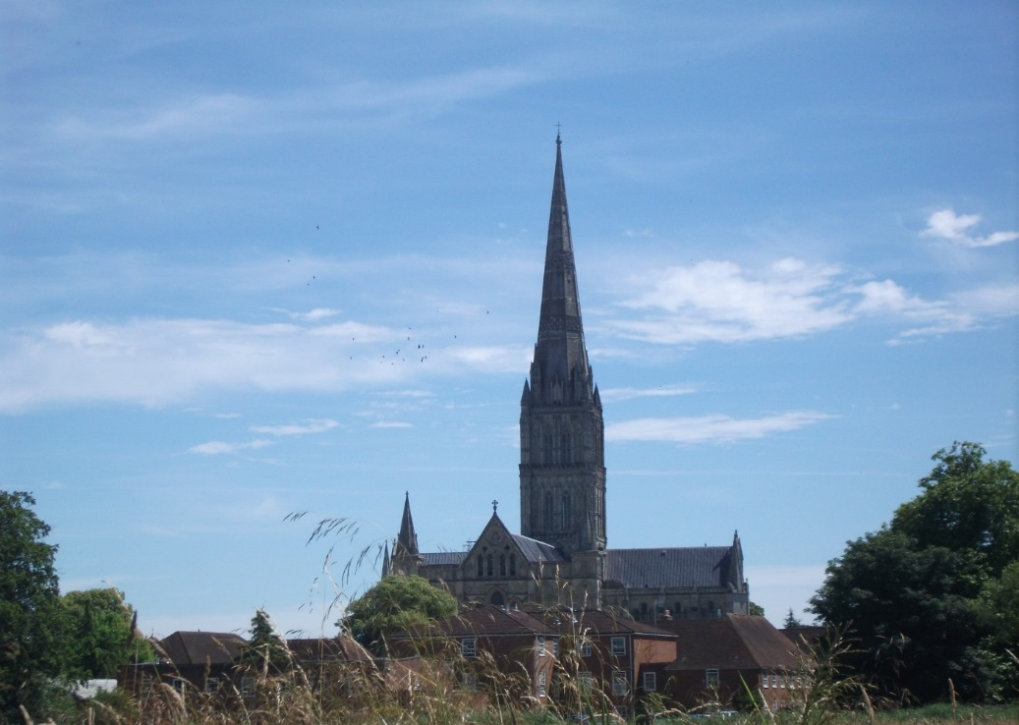
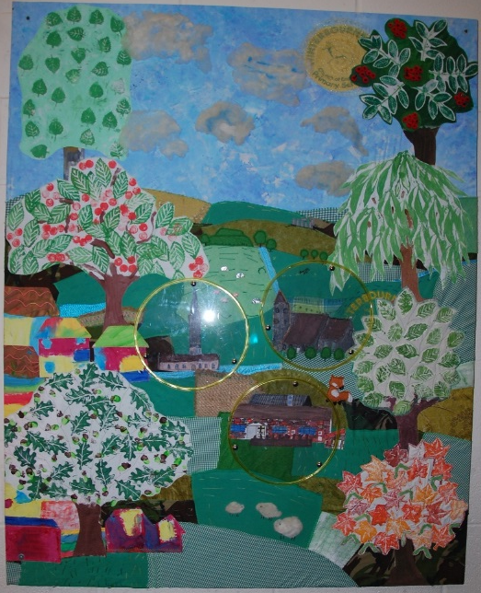
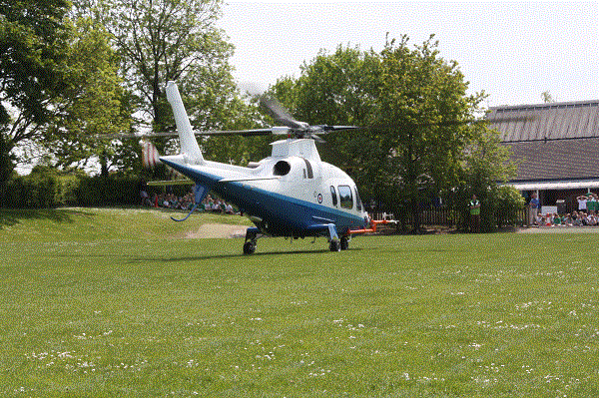
Welcome to Science at
Winterbourne Earls C of E Primary {WBE}
We are delighted to work closely with other local schools in our East Salisbury Primary Cluster for Science. Supported and funded by each school’s Head and Governors and the PSTT, we work very well together and have a significant impact upon the science and learning of our own and local children.
Science
Our Cluster
7
Rural Primary
Schools
We have links with :
*PSTT and *PSTC
*ASE
*IOP
*IMechE
*RMS
*Universities
*Local industry
*The Forces
Links beyond the School
We even used Science as a theme to explore a whole school art study for a local project and exhibition and it became our ‘welcome piece’ in the school entrance. We used a lens / microscope theme for ‘I Spy Salisbury’. We hope you feel welcomed ☺
We engage with science :
*Locally,
*Nationally and
*Internationally

