Slide 1

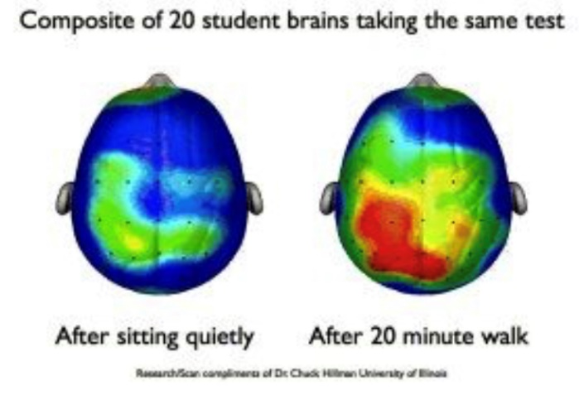

30 Minutes of Physical Activity
Benefits:
Improving their concentration and ability to stay on-task in the classroom
Improve pupils moods and feelings of self efficacy and reduce symptoms of depression and anxiety
Reducing disruptive behaviour, such as fidgeting in the classroom – kinesthetics learners
Improves their cognitive performance – planning, organisation, problem solving and working memory
Improving their motivation and engagement in the learning process
Helping to improve their academic performance
Increase their amount of daily physical activity – which promotes lifelong health and well being and prevents several health conditions
How to achieve this in school?
Active Learning – lessons are adapted to combine movement and learning to promote cross curricular learning
Active Breaks - designed to provide pupils the opportunity to engage in physical activity
Keep activity breaks short 1-5 minutes, perform 2-3 times a day
Use music to help motivate – make sure it is appropriate to the age group, keep it up beat. It is a good way to signal the beginning and end of the break. Also helps with the pacing
Active Environment – activities allowing pupils to be more active within their daily routine

Slide 2
Active Learning – lessons are adapted to combine movement and learning to promote cross curricular learning
1. Maths –
Active Maths www.teachactive.org
Jack Hartaman counting exercises - www.youtube.com/watch?v=0TgLtF3PMOc
Answer in actions – answer the question using actions e.g. 1=Push ups, 2=Jumps, 3=Toe Touches, 4=sit ups
2. Literacy –
Active Literacy - www.teachactive.org
Active Phonics – www.activephonics.co.uk
Finger Spellings - use your finger and write in the air
Stand up for vocabulary – pick a letter every time a word starts with that letter pupils have to stand up, use a poem or story or pick a word
Body Spelling – use different body actions to spell out a word, or the first letter of the word
3. Premier League Primary Stars - www.plprimarystars.com
.
..
4. Orienteering
5. Subject Charades
6. Active Story time
7. True or False – Ask questions if they think True have to do jumps if false touch their toes for example
8. White board answers – eg. partners stand back to back answer a question on the white board then have to perform 3 jumping jaxs and then turn around to see each others answers
9. Multi Choice A,B,C,D – give each letter a movement, ask a question with multi choice answers, pupils perform the movement to show their answer
10. Move around the classroom - to find an answer or to write an answer down
11. Match the answer – Split class in half give half a word or number and the other half the definition or sum, they have to move round and match themselves up

Slide 3
Active Breaks - designed to provide pupils the opportunity to engage in physical activity
Keep activity breaks short 1-5 minutes, perform 2-3 times a day
1. Dance –
Just Dance – www.justdancenow.com
Go Noodles - www.gonoodle.com
Disney 10 minutes shake up - www.nhs.uk/10-minute-shake-up
Free dance (just play music and let the pupils dance) BBC Boogie Beebies -www.bbc.co.uk/programmes/b006mvsc
Musical statues
Movement songs – Head shoulders knees and toes
Party Dances
Murder of the Dance floor – I person is the detective the murderer starts performing a dance move, rest of class follow and every time they change the move so does everyone else, the detective has to work out who the murder is
2. Daily Mile / Daily Step Challenge
3. Fitness exercises –
Jump start Jonny - www.jumpstartjonny.co.uk
Joe Wicks - www.youtube.com/watch?v=mhHY8mOQ5eo
Fitter Future - www.fitterfuture.com
Chair Aerobics - www.classroomexercises.com
Playing cards – pick a card and tat will tell you what activity to do (the suit) and how many
Dice – Pick 6 exercise, each exercise is given a number, roll the dice to decide on the exercise You can decide on the number to be completed
Heads / Tails – two lists of exercise – easy and hard, toss a coin if heads pick something off that list
Mirror Image – partners face each other one performs other person copes
Aerobic / Zumba routine
Uno Fitness – use Uno cards for the number of times to perform the activity, colour for activity choice and special cards

Slide 4
Fitness Bingo – let pupils pick 5 numbers out of 20, call a number if they haven’t chosen that number they must complete it, if they have it they tick it off and do a celebration move. See who gets bongo first
Connect 4 – use the connect 4 board, perform the move then cover it with your colour, winner who ever gets 4 in a row
Spell your Name – give each letter an exercise spell you name in exercises
4. Skipping - www.skip2bfit.com/skipping-workshops-for-schools
5. Dough Disco - www.spreadthehappiness.co.uk/dough-disco
6. Yoga –
Cosmic Yoga - www.cosmickids.com
Yoga for kids - www.youtube.com/watch?v=X655B4ISakg
7. Go Pro Bob Sleigh – pretend they are on the course mimicking the movements
www.youtube.com/watch?v=Xp9L1JZT9X0
8. Simon Says – Play the air guitar, bow, move like a robot
9. Action Acting – Teacher calls out an action pupils must act out the movement eg. Swimming, basketball shot
10. Follow the leader / Beat / Commands– eg. tap knees, tap shoulders, clap. Walk in different ways
11. A balancing act – practice balancing one 1 foot, see what they can do with their arms as the balance (try dominate and non dominate foot)
12. Rainstorm – 1. lightly rub hands together 2. click fingers 3. slap thighs 4. slap thighs and stomp feet – repeat backwards as the storm starts to disappear
13. 60 second challenges – see YST cards
14. Sporting actions – pretend to perform some sporting actions e.g. basketball set shot, shooting an arrow, serve in tennis

Slide 5
14. I went to the gym – play the game where first person performs the action, next person performs that action then adds on a move and repeat
15. Around the clock – every quarter past, quarter two, half past and o’clock stand up and perform an action
16. Warm up games - Beans, Traffic lights, Pirates, DVD remote, Mobile phone, Mr Men, Animal walks
17. Rock, Paper Scissor tournament
18. Remember the sequence – teach a short sequence of exercise or moves then give commands – forward (perform the sequence), rewind (reverse the sequence), Pause (hold that move for count of 10 then carry on)
19. Use equipment – e.g. passing a bean bag around the class, play domes and dishes
20. Brain Gym – Movement actions where you cross the midline
21. AS IF …… - give instructions e.g. Jog on the spot AS IF a big scary bear is chasing you
22. If your happy and you know it – sing the song change the words eg, bend your knees, jump in the air
23. My day so far – Act out what you have done so far in your day e.g. get up, ate breakfast, got dressed, cleaned teeth
24. Would you rather / True or False – Ask a questions and students have to answer either by moving so one side of the room or perform a move
25. Create a secret handshake - with a partner

Slide 6
Active Environment – activities allowing pupils to be more active within their daily routine
Lunchtime structured activities led by Sports Leaders or MDSA’s
Active Travel – Walking school bus, Biking
Extra Curricular Clubs – sport specific, Multi Skill, Change 4 Life
Exit the Classroom– before a pupil can exit the classroom they must perform the move of the day
Calendar – create a physical activity calendar for a term so pupils can see what the plan is

