Slide 1
Year 1 and 2 Maths Workshop

Slide 2
Aims of the session:
To understand the age related expectations for your child and address misconceptions
To understand what Mastery is and the benefits of it
To look at new models linked to Mastery
To work with your child on Mastery tasks
To feel more confident supporting your child with maths at home

Slide 3
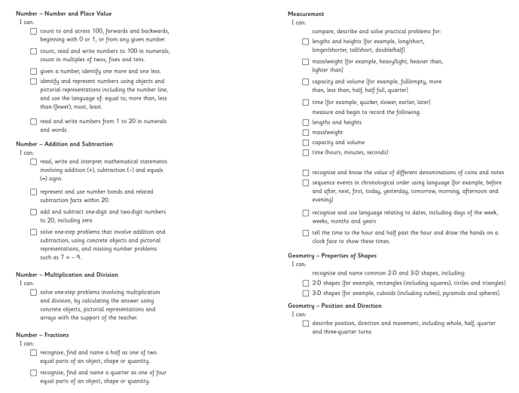
Year 1 End of Year Expectation

Slide 4
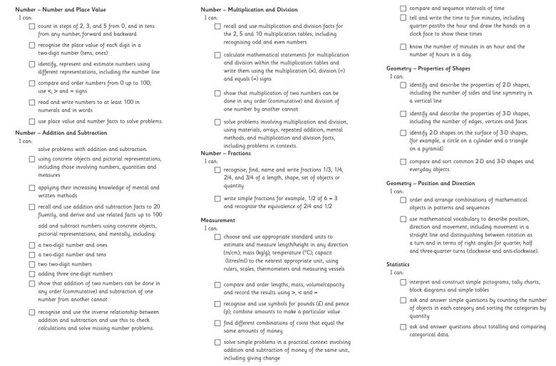
Year 2 End of Year Expectation

Slide 5
Mastery – What is it?
Mastery in Maths is being able to understand and apply knowledge to different contexts and situations.
It can also be explaining thought processes, as well as, proving and giving reasons for answers.
This approach aims to broaden children’s understanding of a concept, enabling them to use what they know in new situations.

Slide 6
Stages of Mastery
Fluency in Maths happens when children can answer questions accurately using recall of Mathematical facts.
Reasoning is when a child can explain what they have done and why, or prove that something is or isn’t correct.
Problem solving is applying their knowledge and understanding to multi-step problems.

Slide 7
Stages of Teaching
Maths learning should follow a process, moving through each stage when the child is ready.
If the child is moved too quickly through the concrete and pictorial stage of their learning, this could affect understanding in later years.
Concrete
Pictorial
Abstract

Slide 8
Focus: Place Value
Sort the questions in Fluency, Reasoning and Problem Solving.
Have a go at answering one or all of the questions.

Slide 9
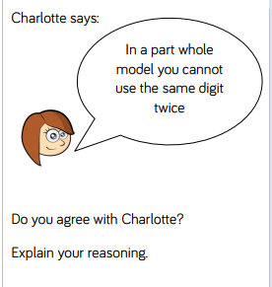
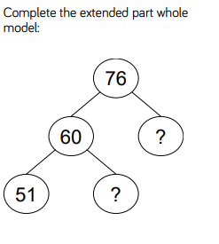
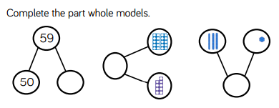
Activity 1

Slide 10
Any questions?
We would now like to invite you to work with your child for about 20 minutes.
We have provided activities for you to work through following fluency, reasoning and problem solving.
Please talk through the questions with your child and discuss the process you are using to answer them.
Please take any unfinished activities home with you to complete with your child.

