Slide 1


KS2 Mathematics Parents’ Workshop – Year 3/4

Slide 2
Aims of today
To get an insight into how Maths is taught in year 3/4.
To understand mastery and what this means in the classroom.
To introduce bar modelling.
To work with your child and take part in a variety of Maths activities.
To take away some ideas to support your children at home.

Slide 3
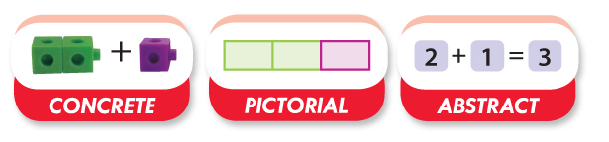
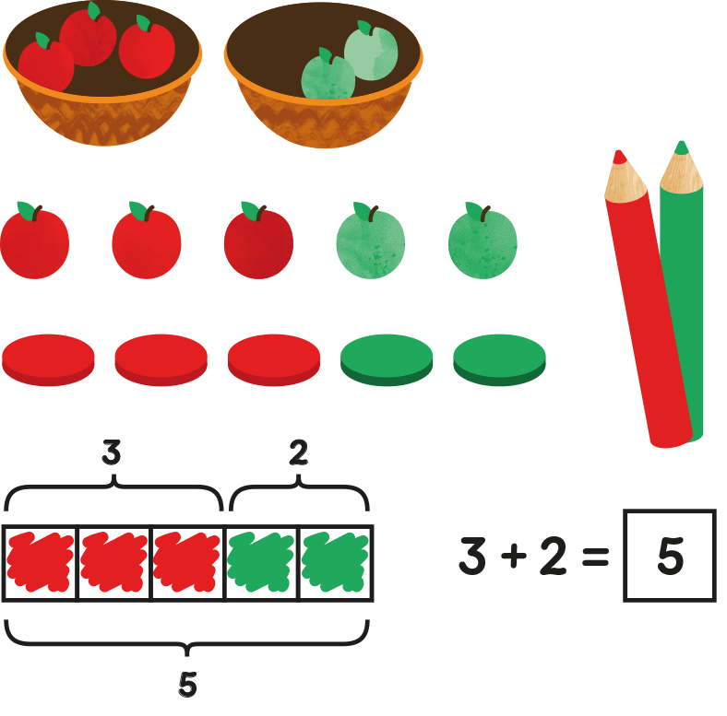
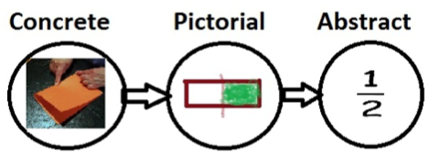
Stages of teaching

Slide 4
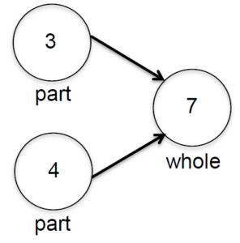
Part-part- whole
There are 8 number sentences from this pictorial representation.
Can you find all 8?
3 + 4 = 7
4 + 3 = 7
7 = 4 + 3
7 = 3+ 4
7 – 3 = 4
7 – 4 = 3
4 = 7 – 3
3 = 7 – 4

Slide 5
What Is Bar Modelling?
Bar modelling is where pictures or ‘bars’ are
used to represent calculations and word problems.
Why Use Bar Modelling?
Sometimes calculations and word problems are difficult to visualise
in children’s heads. Bar models help them to see their maths more clearly.
Once children become confident in using bar models, they can use
them to help thier learning in many different areas of maths.

Slide 6
Bar Modelling
Look at this simple bar model.
What addition and subtraction calculations could it represent?
100
45
55
45 + ? = 100
100 – 45 = ?
45 + 55 = 100
100 – 45 = 55

Slide 7
Problem solving
700 + = 1200
1200
Part
700
Problem solving becomes much simpler when you can visualise it with models or images.

Slide 8
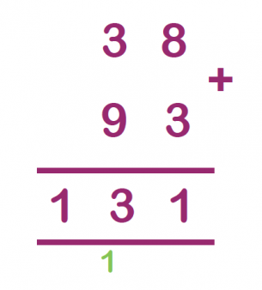
Compact Column Addition
38 + 93 becomes:

Slide 9
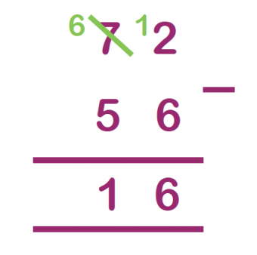
Subtraction
72 – 56 becomes:

Slide 10
What is mastery?
Developing fluency.
Securing understanding and reasoning.
Developing good problem solving skills.
Challenging the children.
Deep and sustainable learning.
Making connections.

Slide 11
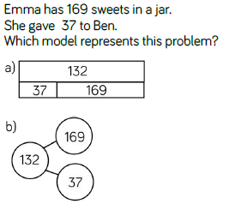
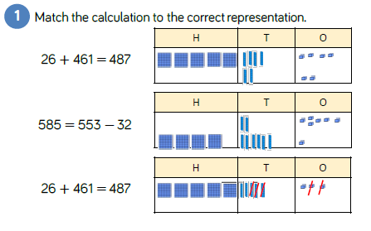
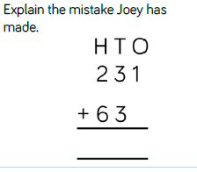
Reasoning and problem solving

Slide 12
How you can help at home?
Number bonds to 20 and the related facts (16 + 4 = 20 so 160+40 = 200)
Telling the time.
To use maths in a real life context.
Cooking.
Shopping
Practise times tables
Support with homework using methods we’ve shown you.
Take a problem solving maths challenge sheet from outside your child’s classroom.
Mathletics

