Slide 1
Maths Workshop Year 5 and 6
The importance of reasoning.
November 2017

Slide 2
Aims of today
To get an insight into how Maths is taught at Winterbourne.
Understand ‘Mastery’ and what this means in the classroom.
To take away some ideas to support your children at home.
To work with your child and take part in a variety of maths activities with a focus on reasoning and problem solving.

Slide 3
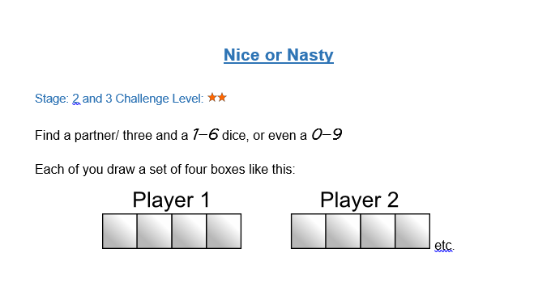
Lets play a game…
Nice or nasty?
Find a partner/ three
See sheet for rules

Slide 4


What is mastery?
Acceleration is piling the boxes one on top of the other trying to get higher and higher to the next level. This is very similar to old style of ‘levels’
Mastery and depth is about opening the box and exploring what’s inside - evidencing learning in a range of contexts.

Slide 5
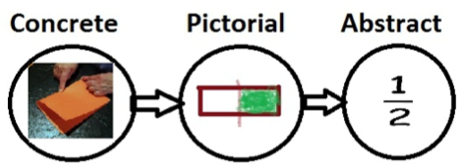
Stages of Teaching
Maths should follow a process moving through each stage when the child is ready. Moving too fast through the concrete and pictorial stage could affect understanding in later years as learning will not be embedded.

Slide 6
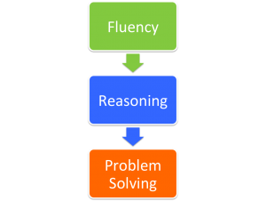
The New Maths Curriculum
Children should:
Become fluent in the fundamentals of mathematics, including through varied and frequent practice with increasingly complex problems over time, so that pupils develop conceptual understanding and the ability to recall and apply knowledge rapidly and accurately.
Reason mathematically by following a line of enquiry, conjecturing relationships and generalisations and developing an argument, justification or proof using mathematical language.
Solve problems by applying their mathematics to a variety of problems with increasing sophistication, including breaking down problems into a series of simpler steps and persevering in seeking solutions. Children should also be able to use logical trial and error to find solutions.

Slide 7
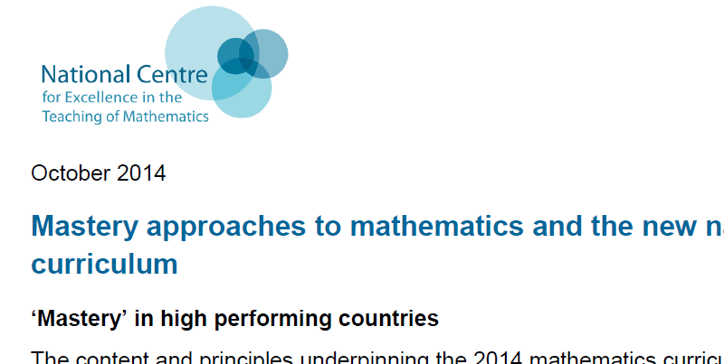
So what does it look like in the classroom?
See NCETM document for more info.
Expectation is ALL children can achieve expected standard in maths and access the same topic.
All children focus on same lesson content
Key concepts such as addition facts and times tables are learnt for instant recall
Pupils who grasp concepts quickly will be challenged through rich and sophisticated problems not new content to develop a deep understanding (e.g. reason and problem solve)
Differentiation occurs through targeted support and intervention, not in the topics taught. Therefore pupils may be grouped according to level of support needed, not ability. E.g. you may have a child who has grasped the concept but needs support with reasoning and problem solving.
In Year 5 differentiation occurs through choice of activity in the form of:
Paddling- practice the concept
Snorkelling- begin to problem solve and reason
Diving- deeper level thinking problem solving and reasoning tasks
Children choose their level of challenge dependent on confidence with the lesson concept assessed in the input and with careful monitoring in order to not put a ceiling on their achievement/ ensure the level is appropriate.

Slide 8
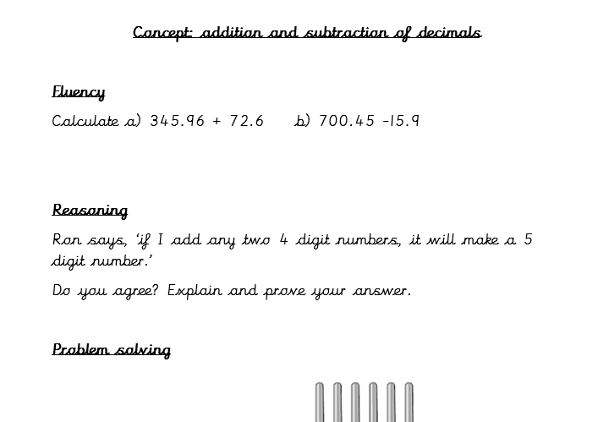
Have a look at an example…. And have a go if you wish
Find this sheet in your pack
Focus: addition and subtraction
Have a look at the examples.

Slide 9
Activities- there are a variety of activities which follow the types of learning process.
Year 5:
Theme: Multiplying and dividing by 10, 100 and 1000
Type of learning tasks on sheet are as follows:
Fluency – calculation problems
Reasoning- explaining thinking/ proving true or false
Problem solving – multi answer problems to solve including multi step problems
HINT: See in your pack for guidance on how to multiply and divide by 10,100 and 1000 if you are not sure how it is taught in school or ask your child as they should be able to explain!
Year 6
Will be having a go at a reasoning practice paper.

Slide 10
Thank you for listening
Any questions?

