Slide 1

Ephesians 4 vs. 16
“As each one does their part, we grow in love”

Slide 2
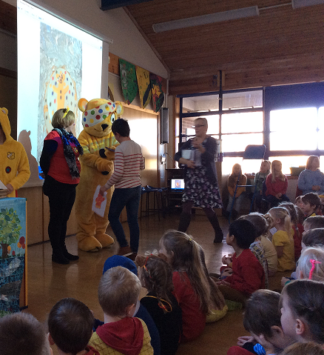
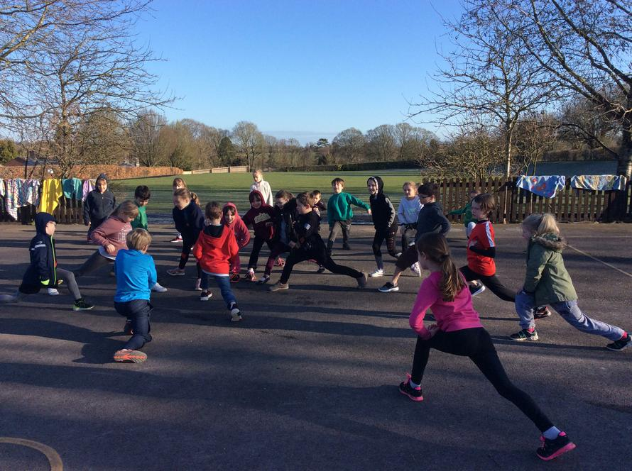

Charity
Our house point scheme is linked to pupil-chosen charities, encouraging the children to be good for the good of others.
Our Parent Association raise a substantial amount for charity each year through the Figsbury Challenge Run.

Slide 3
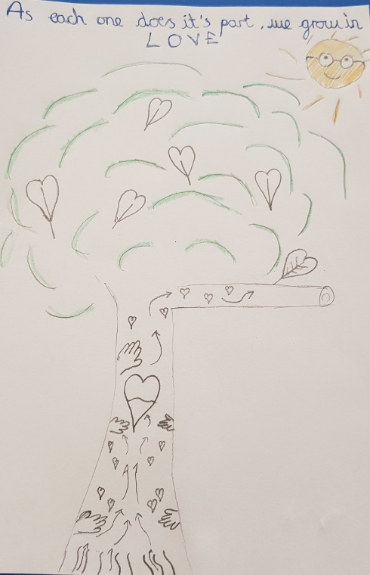
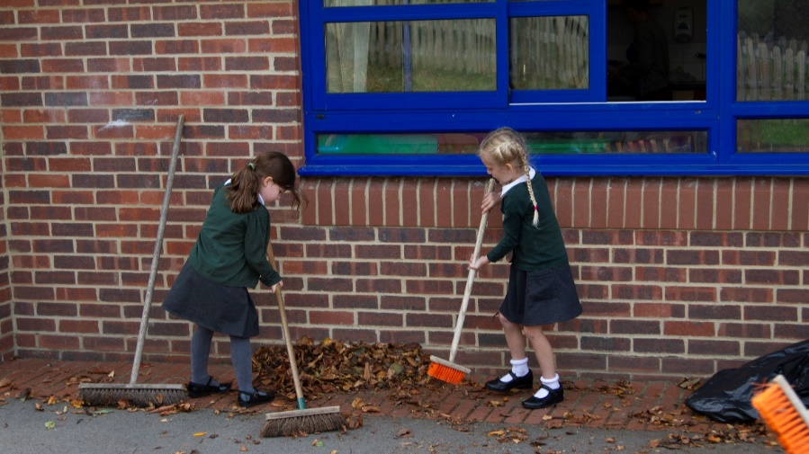
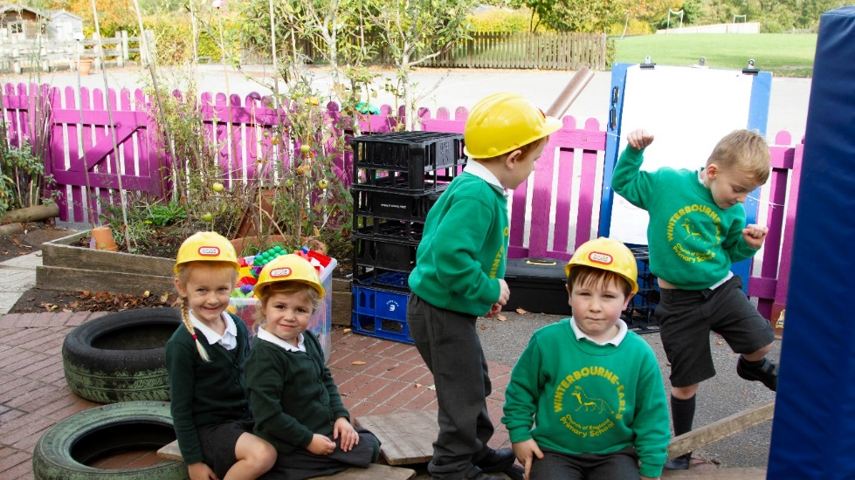
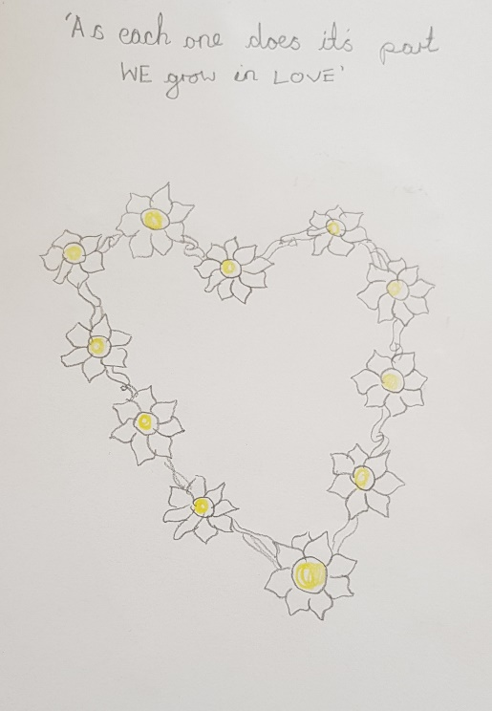
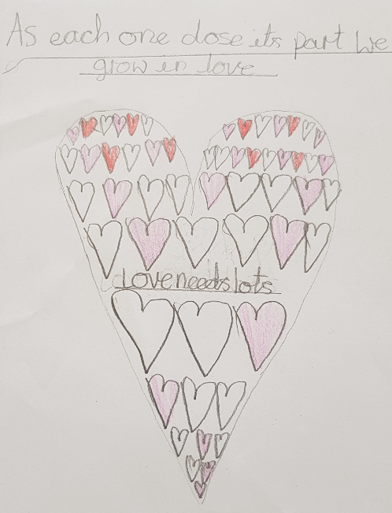
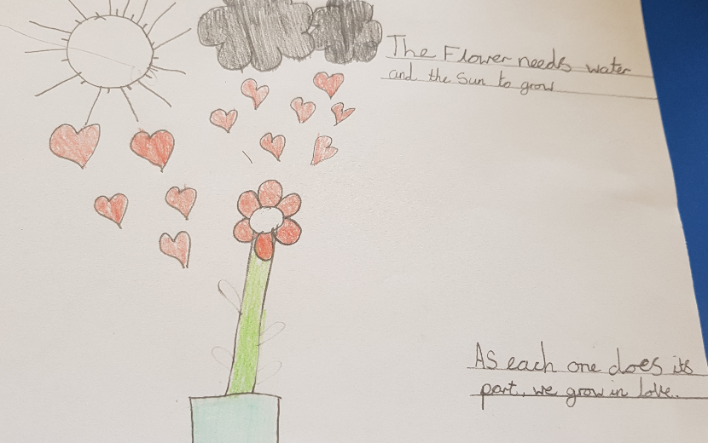
School Vision
“As each one does their part, we grow in love” Ephesians 4 vs 16

Slide 4
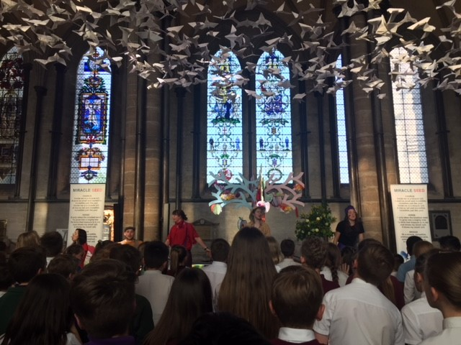
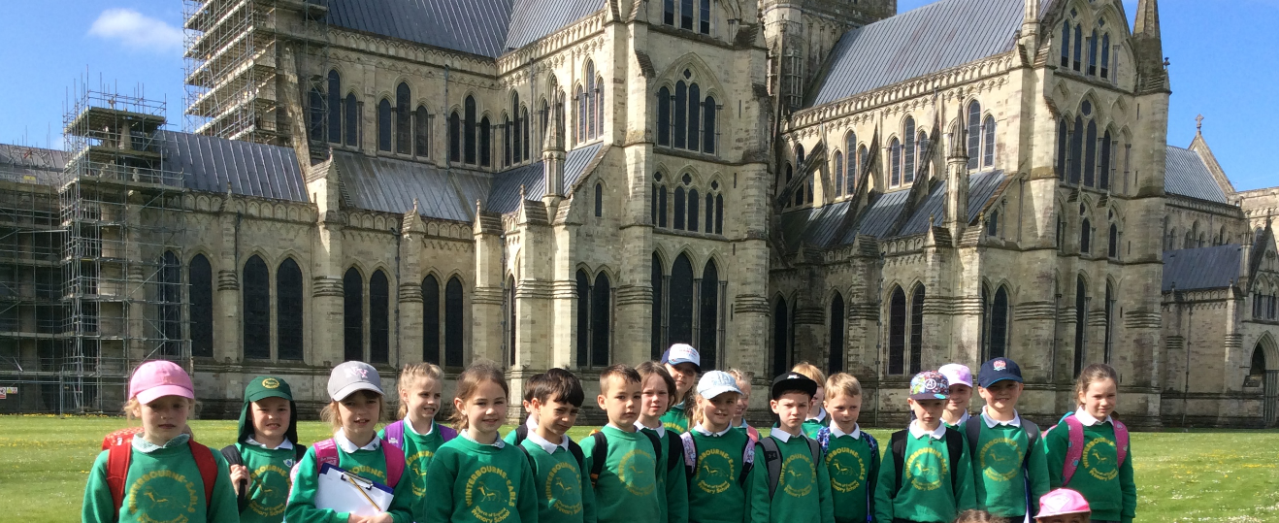
Visits to the Cathedral
Children visit Salisbury Cathedral both as part of the curriculum, but also to celebrate their time at Primary School when they leave year 6.
Y4 attended Cathedral workshop marking the Doves of Peace to commemorate 1918 Remembrance

Slide 5
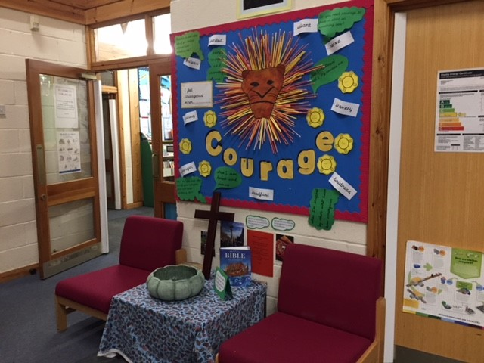
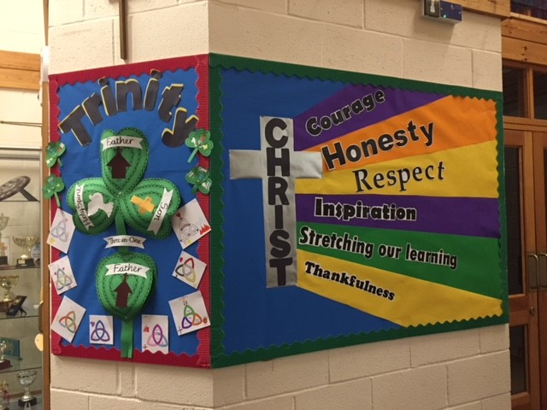
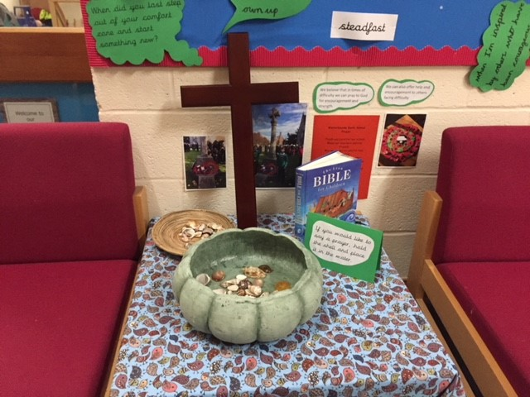
Reflective Areas
Each class has their own Reflective Areas, giving space for quiet thinking time for the children. There is also a prominent Reflective Area for the whole school, with a prayer bowl to which children have access to at all times of the day.

Slide 6
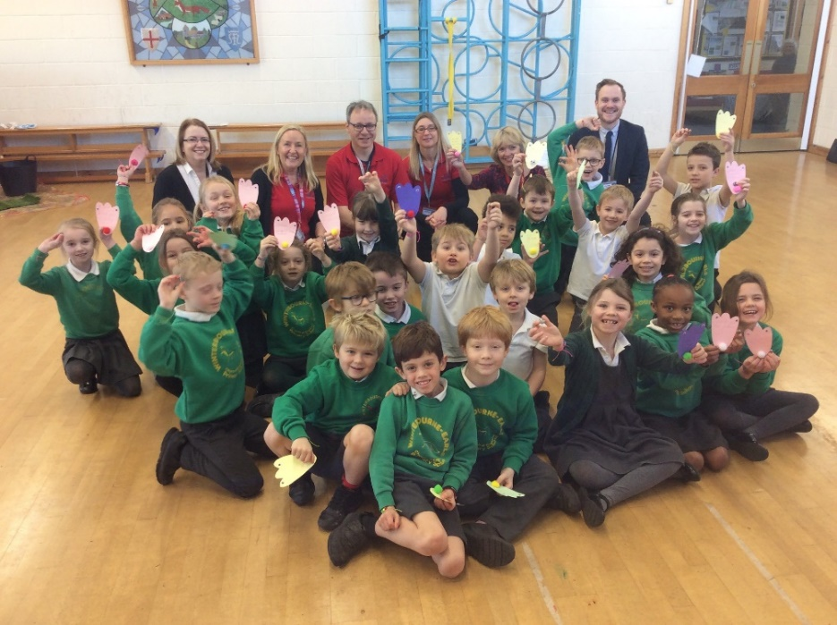
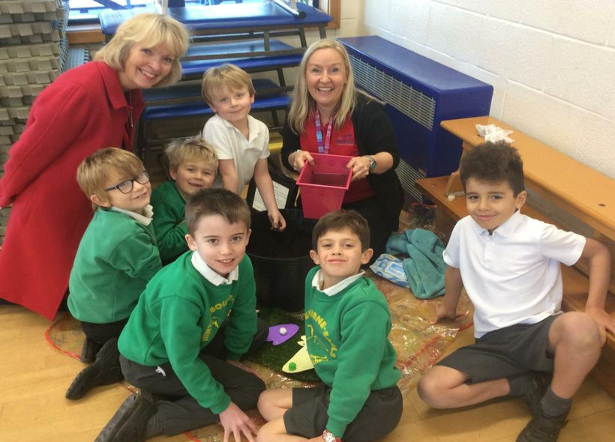
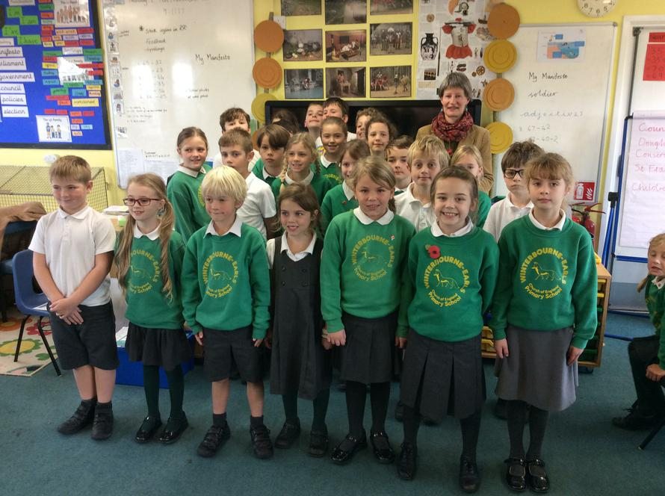
Community Links
Located within a thriving Village community, the school is involved in local ceremonies, Remembrance Sunday services, Church Summer Fete & entertains the local daycare centre regularly.

Slide 7
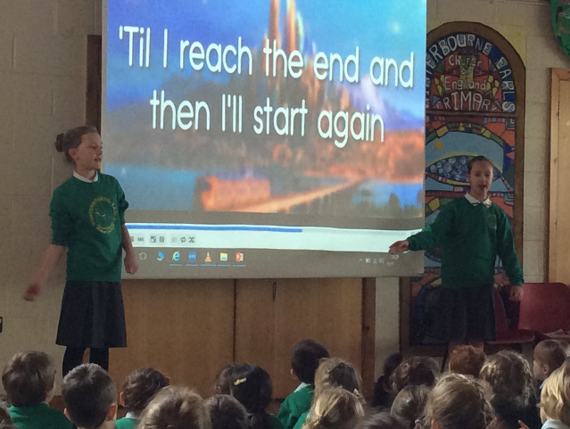
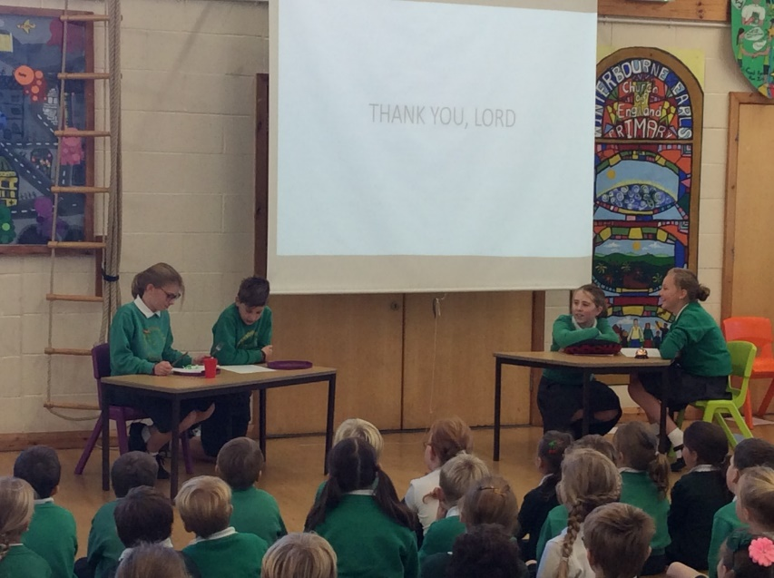
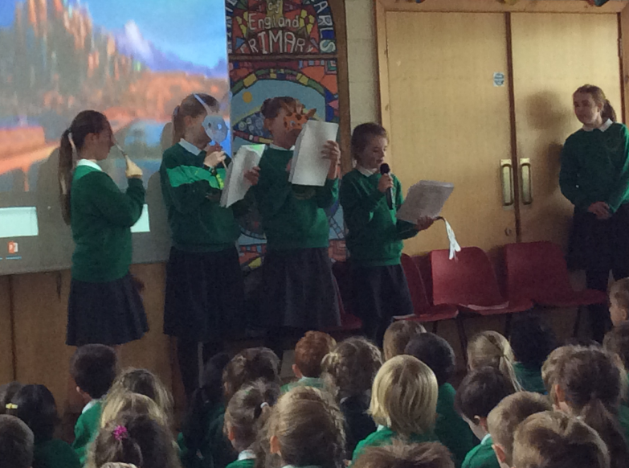
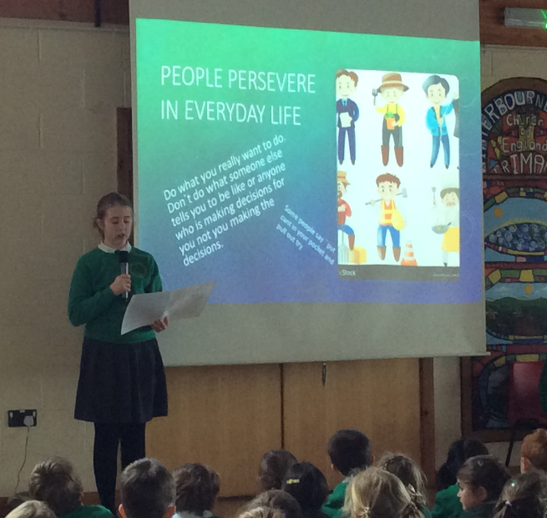
Collective Worship
We have a daily act of Worship, which is led once a week by a member of the local Church.
Year 6 Worship Leaders often lead Worship too.

Slide 8
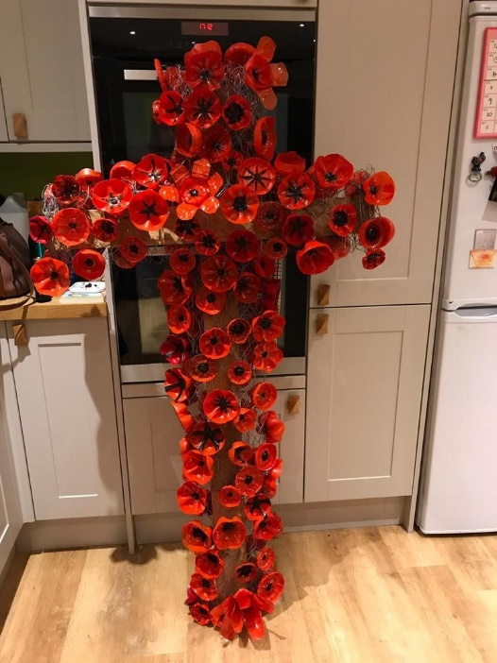
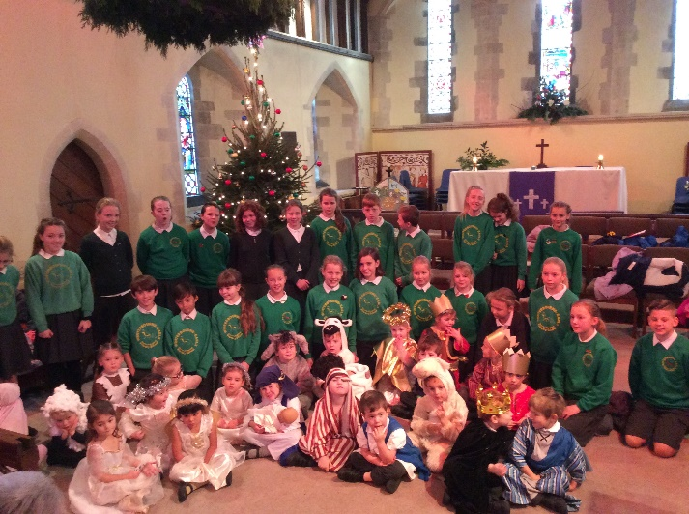
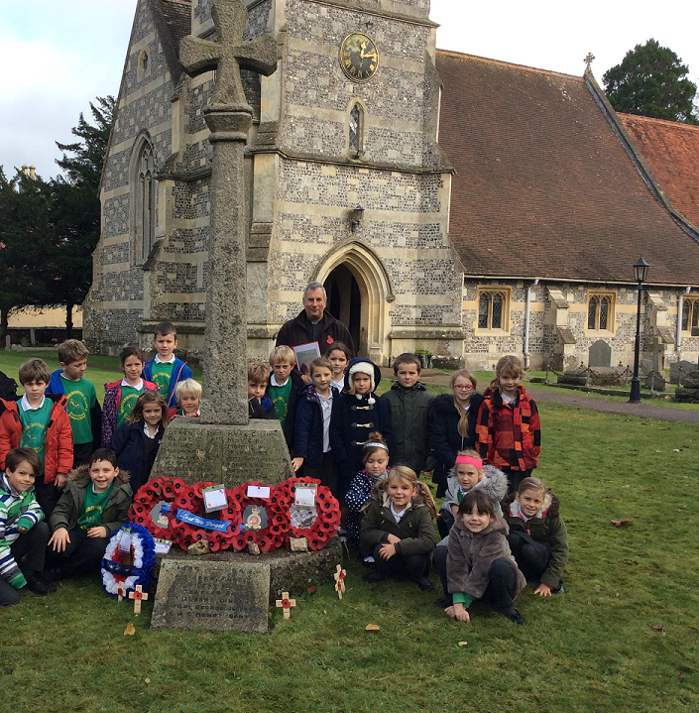
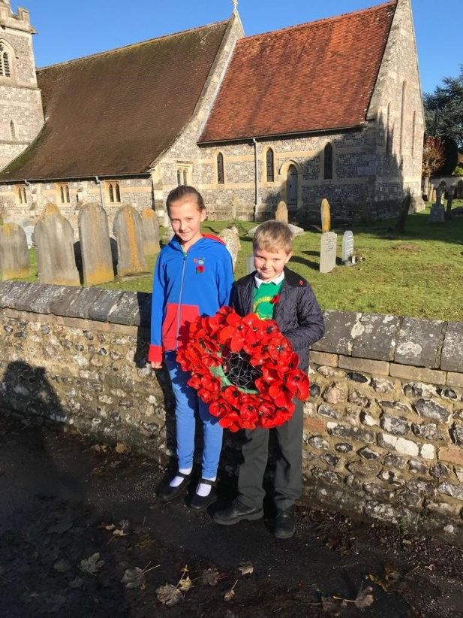
Our Church
Each term, there is a whole school service at the village Church, St Michaels & All Angels
The school is represented at special occasions such as Remembrance and Village Carol Services.

Slide 9
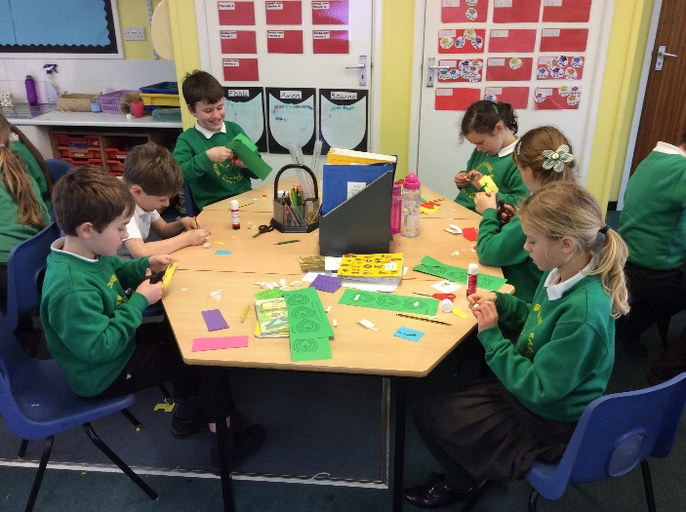
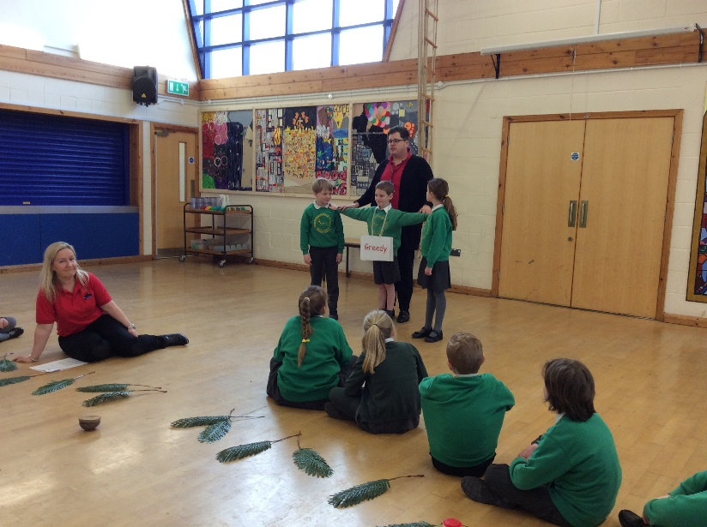
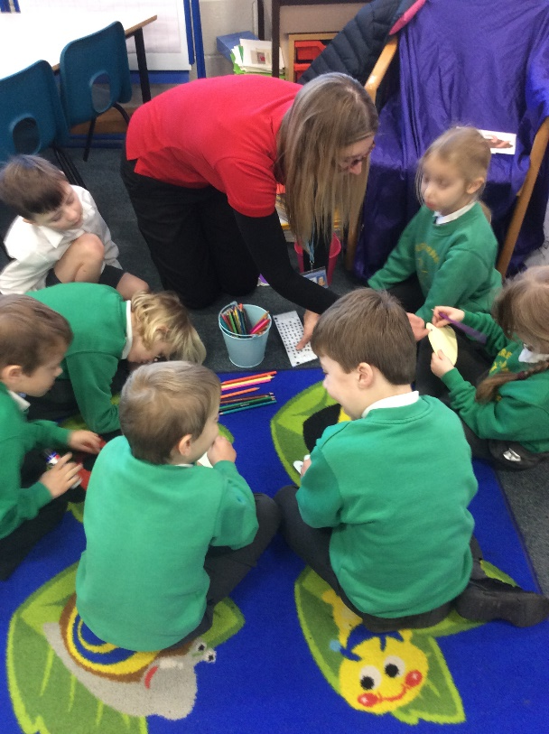
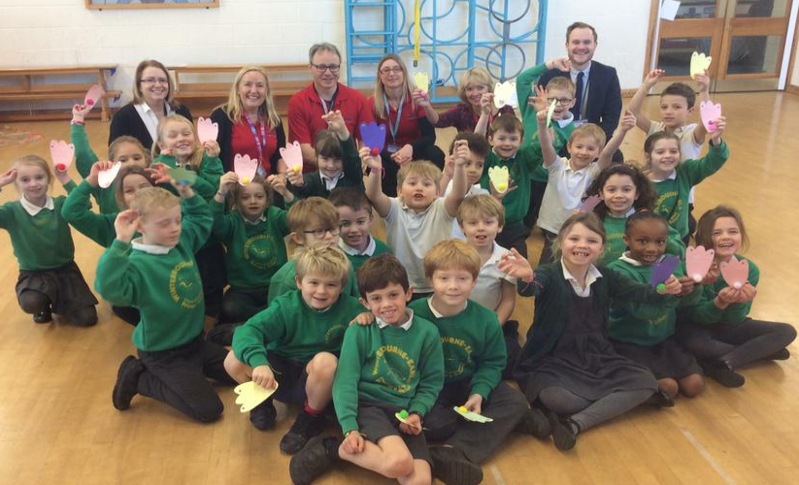
The Bridge
Volunteers from The Bridge, a Christian School Charity, come in regularly to work with our pupils in small group and whole school projects.
Some projects include Prayer Day & Trinity Day.

Slide 10
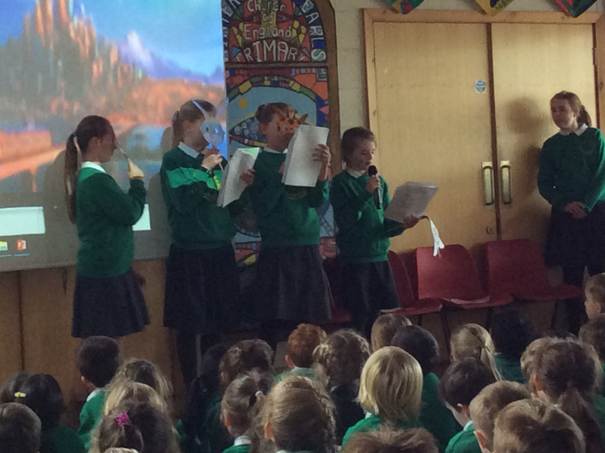
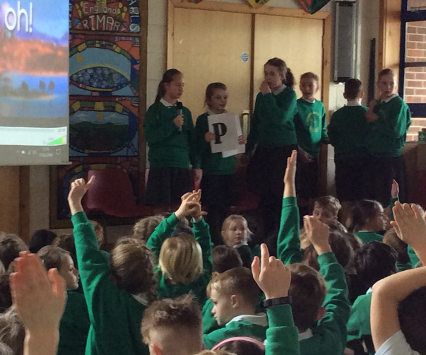
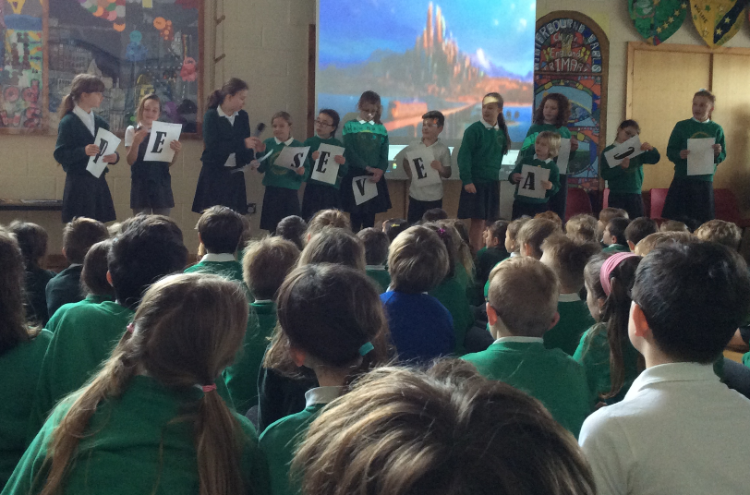
Worship Leaders
A selection of our year 6 pupils, apply to be Worship Leaders, taking a forefront role in the daily act of Worships
The Worship Leaders spend time down at the Village Church.

Slide 11
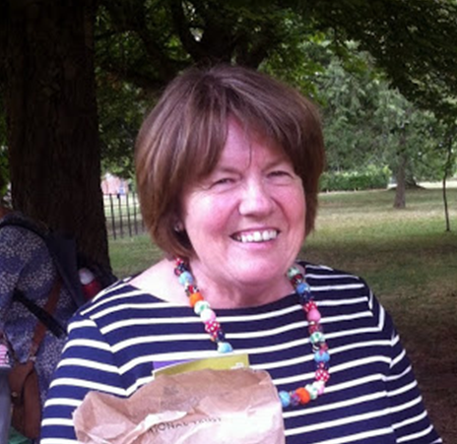
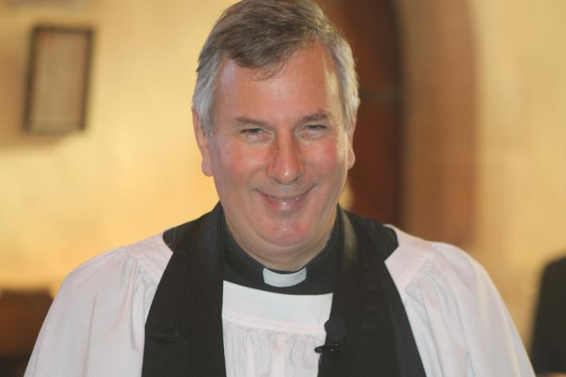
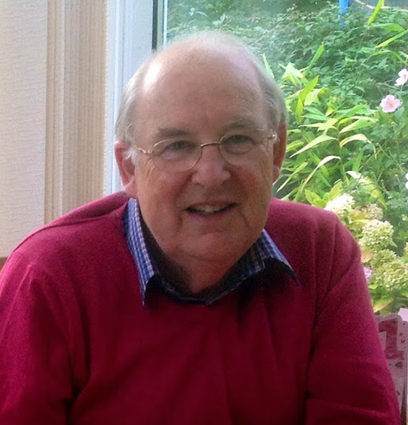
Foundation Governors
As a Church school, our link to the local Church community continues with Foundation Governors appointed by the Parish.

Slide 12
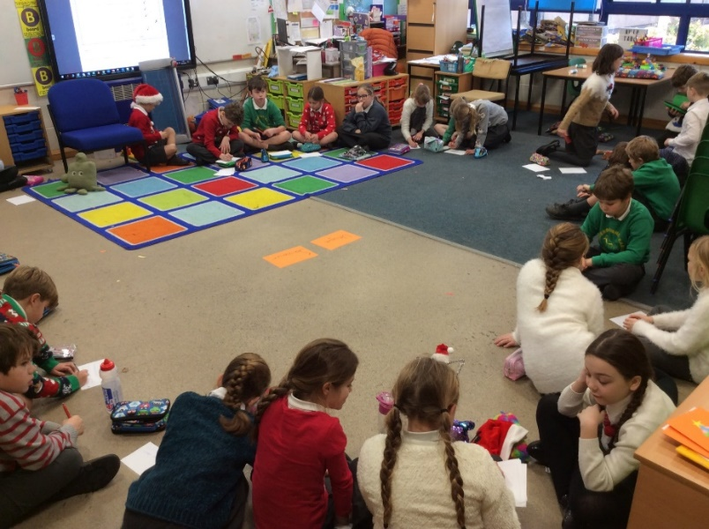
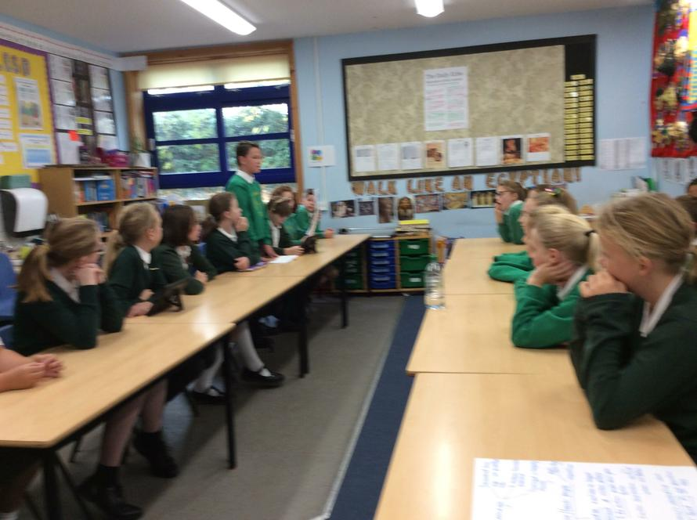
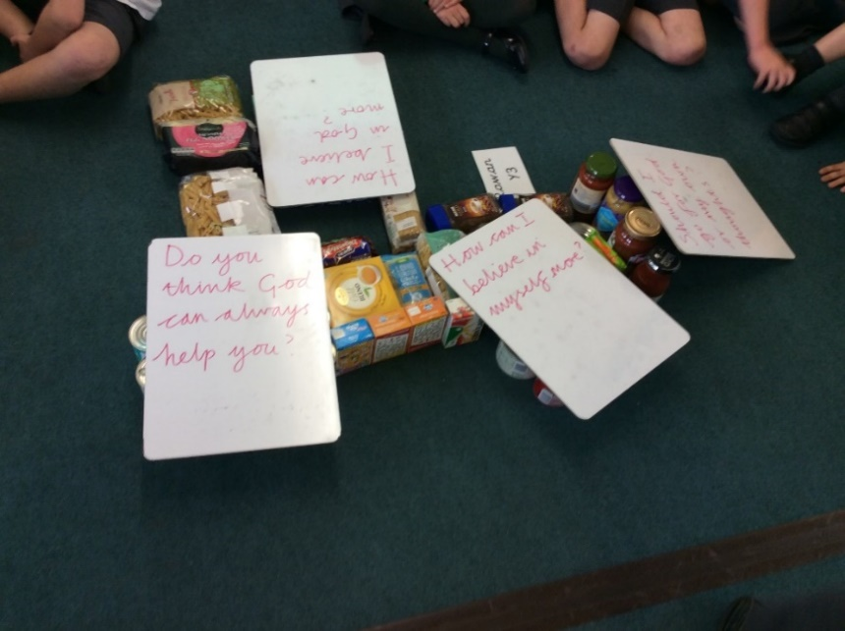
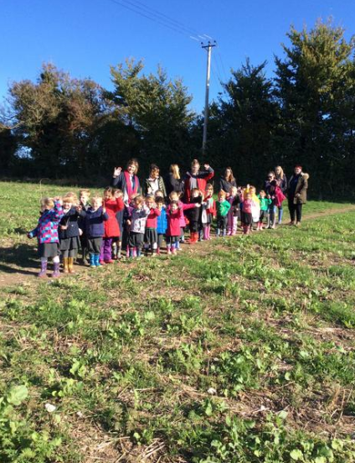
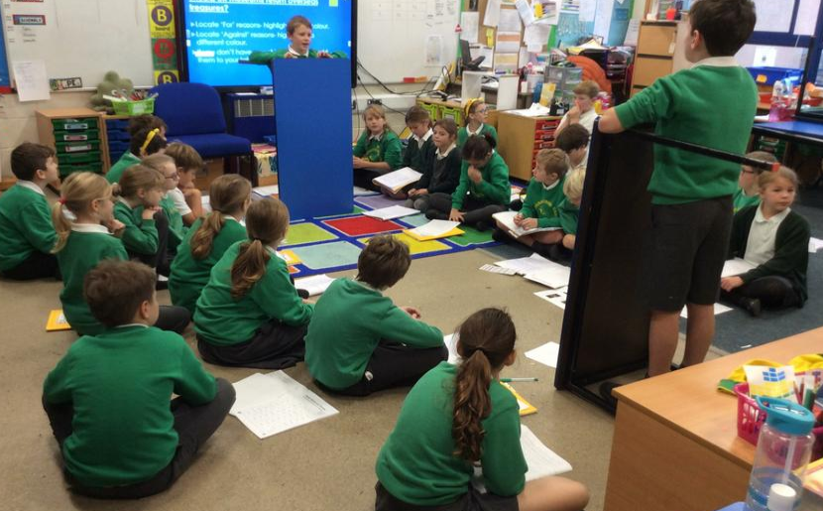
Spirituality
Philosophy for Children and Science & Philosophy Projects

Slide 13
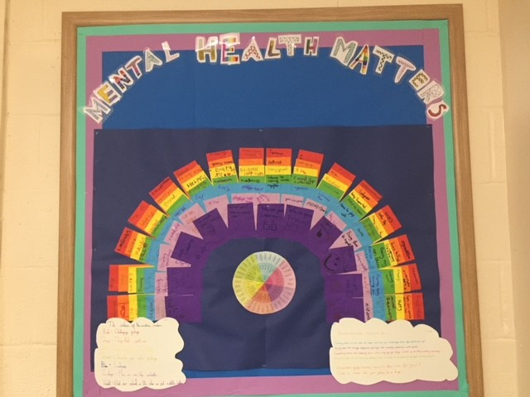
Emotional Well-Being
Emotional Well-Being is at the heart of everything we do. Every child has access to Emotional Literacy support if needed.

Slide 14
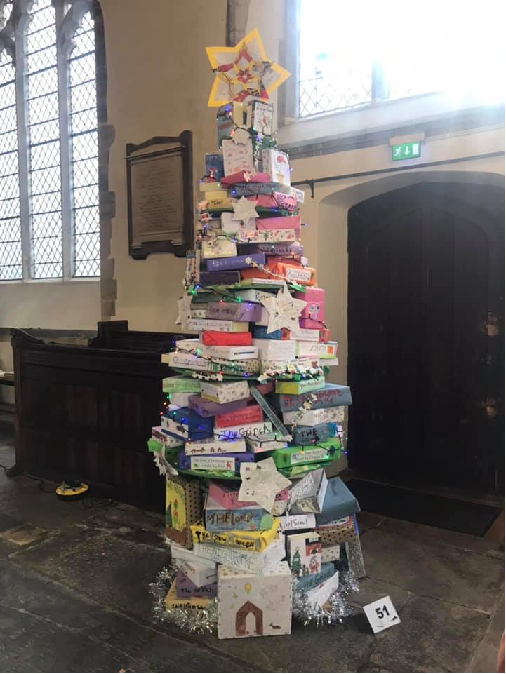
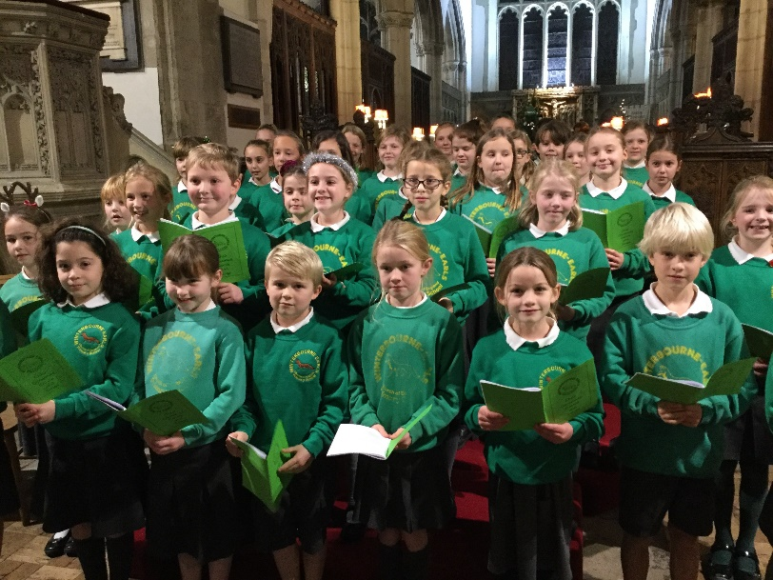
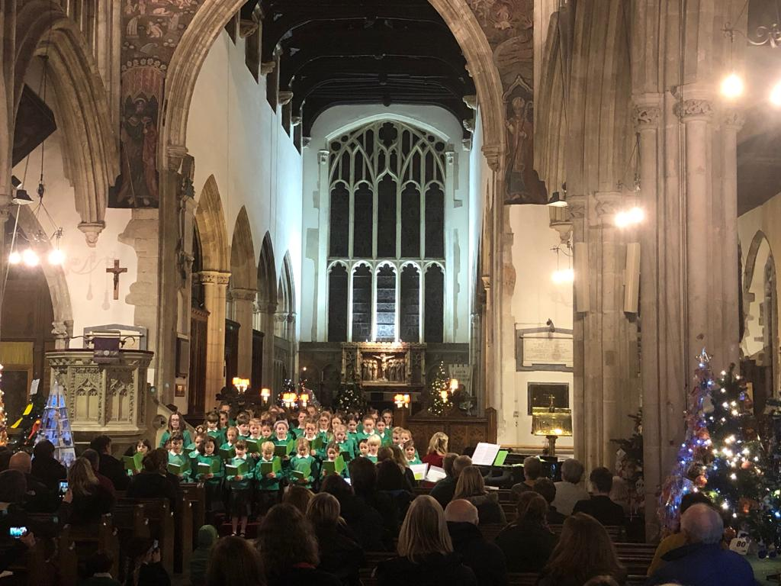
Wider Church Links
Every year, the entire school is involved in making a Christmas Tree for the Salisbury Christmas Tree Festival, held in St Thomas’ Church in town.
Our choir sings carols in St Thomas’ during the Festival.

