Slide 1









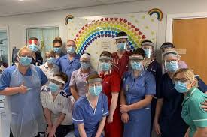


Service
Serve one another in love Galatians 5v13

