Slide 1





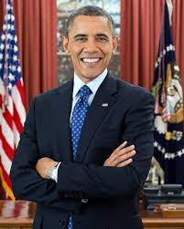

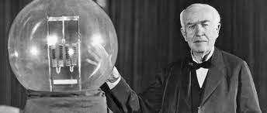

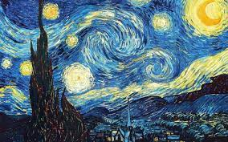
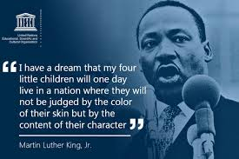
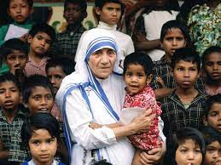
INSPIRATION
"For I know the plans I have for you," declares the LORD, "plans to prosper you and not to harm you, plans to give you hope and a future”. Jeremiah 29:11

