Slide 1



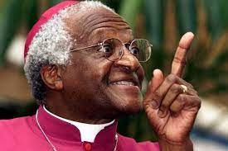

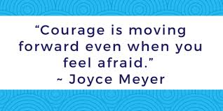


Courage
Be strong and courageous; do not be dismayed, for the Lord your God is with you wherever you go. Joshua 1 v 9

